Slide 1
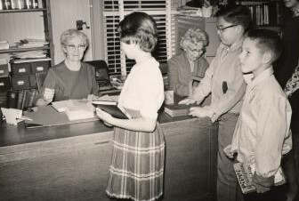
Experiments in Innovation
LYRASIS Leaders Forum 2018
Jacksonville
by Robert Miller
Notes:
Impact and Innovation –
Why are we here?

Slide 2
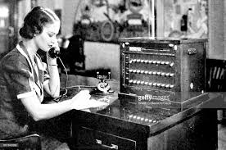
Experiments in Innovation
Notes:
Impact and Innovation –
Why are we here?

Slide 3
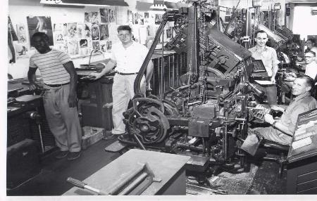
Experiments in Innovation
Notes:
Impact and Innovation –
Why are we here?

Slide 4
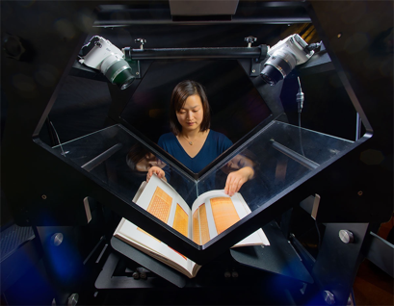
Experiments in Innovation
LYRASIS Leaders Forum 2018
Jacksonville
by Robert Miller and Lisa Larson
Notes:
Impact and Innovation –
Why are we here?

Slide 5
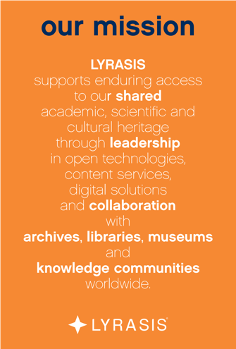
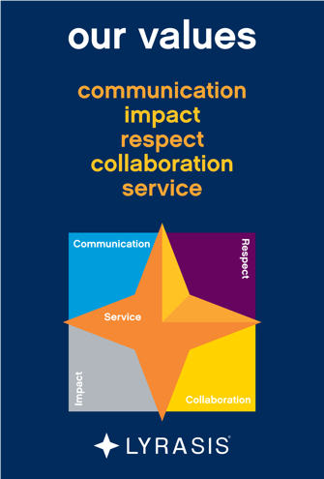
Driving Us Forward – Foundation Documents

Slide 6
Where are we focusing and who do we work with ?
Our core is Academic libraries, Public libraries, Museums, Archives and Galleries.
Our core members have a combined budget of $3.94 billion
Impact at the community levels – small, medium and large
  Academics – we directly work with 30% of 4 year institutions. Strategy is to increase and build off of strength in eContent and Licensing and leverage our work in services
  Publics – Partnering with Digital Public Library - SimplyE to engage with all publics by working with key influencers – set standards, establish fair pricing and governance
  Museums – Partnering with Andrew W. Mellon. CollectionSpace - Services, training and support
  Archives – Partnering with Founding Inst. – ArchivesSpace; leverage end-to-end solutions, services, training and support with 350 institutions

Slide 7
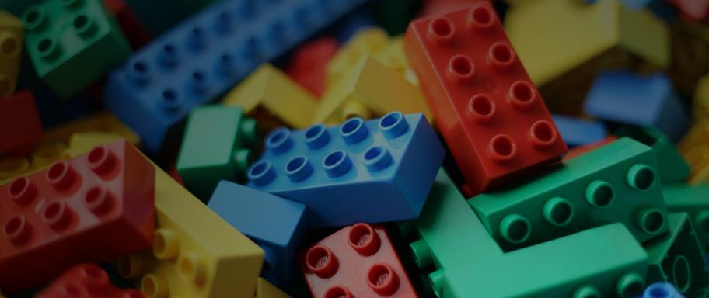
How are we organized?
Building and sharing expertise in …
Training, Consulting
And Licensing
Technology
And Fiscal
Services
Open
Source Software
Notes:
We are continuing to build expertise in LYRASIS in the areas of open content, Oss and technology services- as our path to transform LYRASIS to being much more than just a value add consortial buying organization

Slide 8



How do we reach out? Leaders Circle, Leaders Forums and Catalyst Fund
​Leaders Circle
The LYRASIS Leaders Circle – 101 institutions - a diverse group of knowledgeable professionals working together in a highly collaborative and results-focused environment to discuss challenges and design and foster real-world solutions within our community.
Catalyst Fund
LYRASIS created the $100,000 Catalyst Fund to help our members all punch above their weight and to fill in funding gaps identified by the Leaders Circle. To do this, we devoted a portion of our organizational endowment as seed funding to translate these fantastic ideas into real world projects. Members can apply for kickstarter awards to help develop new ideas and programs to benefit the wider field.
Leaders Forums
Over the past 2 years, LYRASIS has hosted 22 Leaders Forums, regional in-person meetings pulling together a diverse cross section of thought leaders to discuss, dissect and focus on cross-functional opportunities. These sessions have become the ideas factory for our Leaders Circle, and help us identify the needs, challenges and opportunities you face on a daily basis.
Notes:
Our new thought leadership model – taking the best knowledge our 50+ world class (staff) experts have and turning it into thought leadership through our top most innovative and receptive members

Slide 9
Measurements - Key elements of our strategy
Impact – help our members punch above their weight, be a part of national and international programs while also celebrating their localness
Good is giving our members what they want, great is giving them what they need.
End-to-end solutions that scale are better than one offs
Fair pricing and sustainable models must be our collective goal
Create value that far exceeds the actual cost to a member
Be the organization that our members can count on and depend on
Eliminate silos for content, think in terms of linkages and connections
Connect the back office to the front office.
Notes:
.

Slide 10
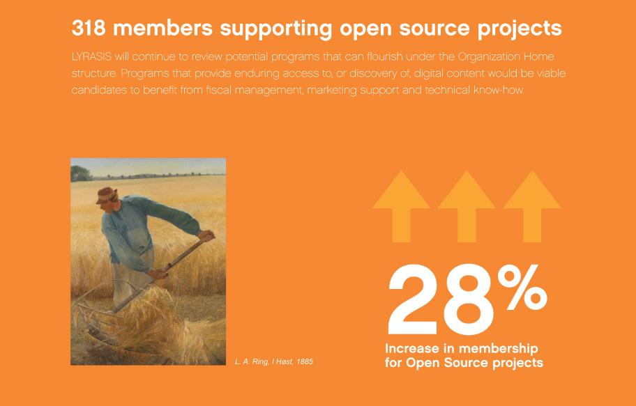
Trends - Open Source Programs
Notes:
This past year we have had incredible success in these 3 areas- OSS growth, tech services growth, open content growth- we have the right team in place, we are fiscally stable, and an excited and engaged member community.

Slide 11
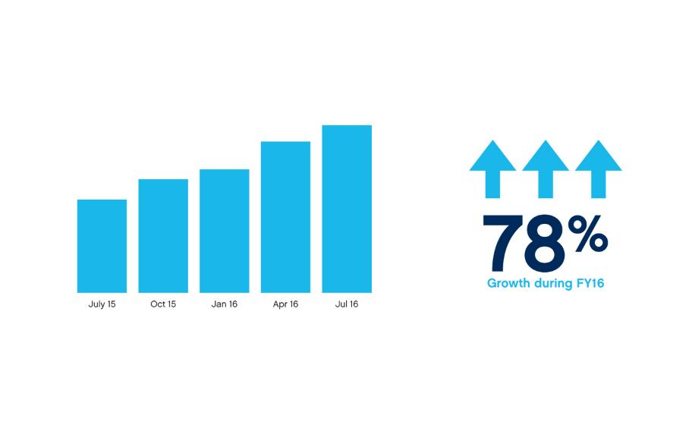
Trends – Outsourcing, Growth in LYRASIS Hosted Clients
Notes:
This is one of the new areas we have been expanding into – our digital services division.

Slide 12
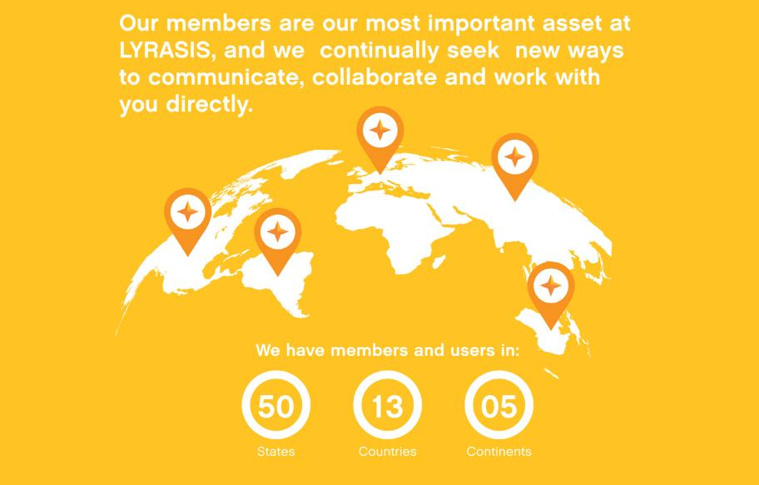
It’s about you - LYRASIS Members
Notes:
Our member base is over 1,000 institutions and over 3,000 users. We have gone on the road and have talked directly to over 200 institutions and over 300+ individuals at our regional leaders forums. What we heard is that our member are excited about LYRASIS’s transformation and our leadership role in working with our communities to solve big problems; specifically in the areas of content, technology and software.

Slide 13
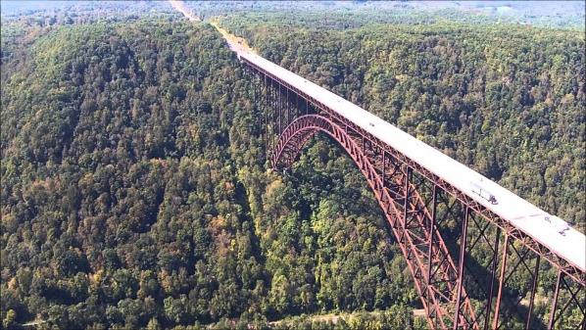
New River Gorge Bridge, WV
Connecting communities
Eliminated dangerous, 45-minute canyon drive
Longest steel bridge span in the western hemisphere
  And 3rd highest in the U.S.
Bridge Day - BASE jumping icon
  Largest extreme sports event in the world
Notes:
How does a non-profit, member-based organization, not only susain itself but actually launch “Innovation” as a strategic business initiative, assuming its inherent risks,
to sustain and grow as an organization,
on behalf of its members?
As a multi type member org -
What we see in connections that weren’t part of the original problem to solve.

Slide 14

It All Started Three years Ago …..
Lots of project-level Innovation
Focused on Operational Effectiveness
  Getting better at what we already do
  Innovation with a small “i”
Looked in the mirror / Needed a broader, cultural change because …..
Operational improvement is not a strategy for getting to the next level…
Notes:
It means doing similar activities as other organizations better.
It means doing similar activities as other organizations with less defects.
This is foundational

Slide 15

Expanding Our View
Pivot toward Innovation as a Strategy
Innovation (with a capital “I”)
External –
  Add VALUE to our members
  Separate ourselves from marketplace
    Avoid this competitive convergence
  We believe we are VERY different from other “similar” consortia
Internal –
  Establish an Innovation Process to create an advantage for members
    e.g., LF>LC>C$F
  Act/Launch instead of React/Crawl
  Build for scale and the long-term
    Local / Regional / National
Notes:
Operational Effectiveness is NOT a strategy for getting to the next level
Internally focused
Doesn’t address market changes and shifting member needs
Not a significant market differentiator
STRATEGY requires trade offs, where Operational effectiveness does not.
TRADE OFFS create need for CHOICE.
The LYRASIS path to INNOVATION with a Big I is our structure for CHOOSING.

Slide 16
The Innovation Question
?
How does a non-profit, member-based organization launch “Innovation” as a strategic initiative, assuming its inherent risks,
to sustain and grow as an organization,
on behalf of its members?
Notes:
Strategy requires
TRADE OFFS create need for CHOICE. The LYRASIS path to INNOVATION with a Big I is our structure for CHOOSING. If you try to be all things to all members, or customers or clients – the mission begins to lose clarity, value props are lost and we don't know who or what we are.

Slide 17
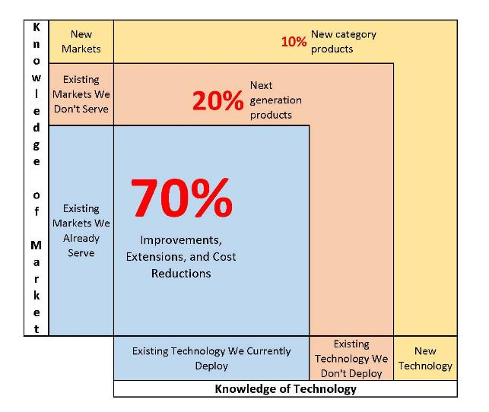
The 70/20/10 Rule – Striking the Right Balance
Knowledge of Technology and Market
Notes:
(LISA) LYRASIS has 2 personas
Leaders in Content
Leaders in Convening the Communities
Hurdles to overcome with both having a process and having the right technology
If you are a leader in your organization and you are fearless, you are likely in the 20%. A partnership might enable you to get into the 10% w/o impacting your staff. We are modeling our organization to be the COO to your CEO in order to allow our members to get into the frontier without threatening your need for organizational stability and efficiency. This is how we are becoming a consortium like no other – in the traditional sense.

Slide 18

Innovation Process
Staff
Members
Catalyst Fund
Stage 1: Concept
Ideas can come from anywhere
Stage 2: Pre-pilot
Stage 3: Pilot
Stage 4: Early Adopters
Stage 5: Launch
“Graduates” to formal product/service offering
Notes:
Our new innovation process. Stage 1 Ideas can come from any where (staff C$F). Where we assess the FAB, financial model, market research
Stage 2Pre pilot – gather information, requirements, staffing, marketing input
Stage 3 we put it in a sandbox, no risk , throw it away, still in dev
Stage 4 – move to the production environment
At Stage 3 its iterative, can go back upstream several times.
There is a lot more underlying structure

Slide 19
Some Concepts We Are Working On
SimplyE Academic
Strategic Partnerships
Knowledge Management
Data Governance
  Migrations en masse
Technology End-to-End
  Integrating platforms for enterprise-level support
  Machine Learning

Slide 20

Discussion Questions
How would you describe the level of risk-taking at your institution?
  Do you stay within the 70% or venture out into the 20/10%?
Is LYRASIS’ commitment to Innovation more or less than what you’d expect?
  Is this different or similar to what other membership orgs are doing?
Do you have similar examples of strong innovation at your own institution?
  Or are other initiatives too challenging to be addressed?
Are we telling this story correctly? Does this resonate with you?

Slide 21
Catalyst Fund: Recipients and Next Steps
Tweet #lyrasis
Meaningful Dialogue | Thought Leadership | $100,000 to Fund New Ideas | Ideation Sandbox

Slide 22

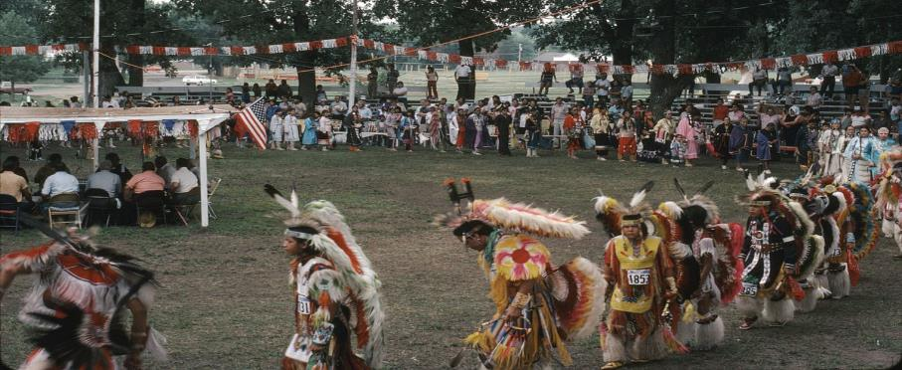
Mobile Digitization for Rural Archives
Working with tribal colleges and communities in Nebraska
Notes:
In recent years, archivists have identified the need and desire to capture community archives materials—those that are not deposited at an institution, but rather remain in family or community collections. The University of NE, Omaha project is exploring the use of a mobile maker space and digitization lab that allows the organization to reach out to rural communities and digitize their material, making such material widely available while keeping the archive in the community.
They have received matching funds that doubled the project budget from the University
Their white paper will talk about how to apply this in other rural states
Mobile labs have been used before, but only in urban areas, and never with tribal members

Slide 23

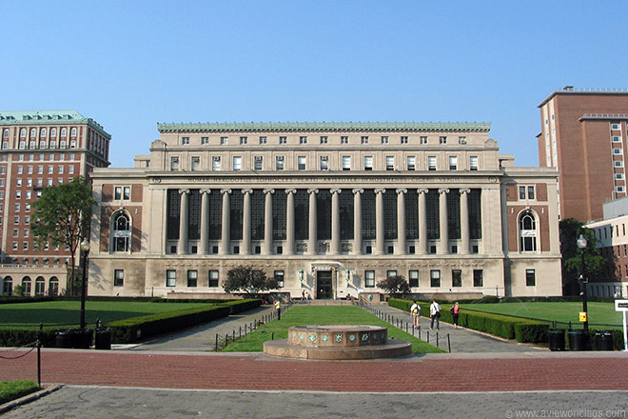
Feasibility study for Copyright Education Center
Notes:
The Catalyst fund was used to scope out the potential for a multi-partner approach to professional development education.
The outcome of the LYRASIS grant clarified potential and a road forward. In addition, Columbia has already modeled another project that is unrelated on the same collaborative approach.
They are now moving to detailed business planning and then implementation
Look for updated copyright education classes for the field coming next.

Slide 24

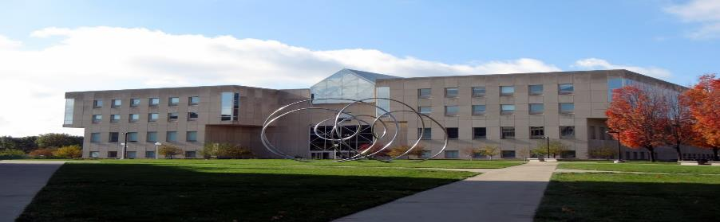
Advancing 3D digitization and Metadata Conventions
To move towards standards for scanned 3D artifacts
Notes:
National* and international** surveys have been conducted regarding the use of 3D imaging and user requirements in cultural heritage institutions. Based on survey results, utilizing 3D technologies in libraries, museums and archives is in its infancy.
The survey’s points towards usage possibilities (ability to remotely measure true size of objects) and desired user requirements (easy online viewing and navigation) yet there was no comprehensive understanding of what constitutes 3D image quality and description for exchange, preservation, and access of digital artifacts.
This project will vett those standards nationally—and museums, archaeology and anthropology collections, galleries and others with 3D works will be able to implement these standards with their own collections…
*(Urban, 2015)
**(Hess, 2015)

Slide 25

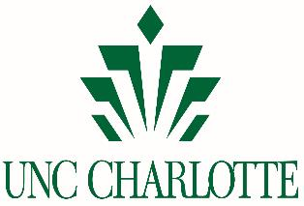
Leverage IOT Devices to discover Collections
Notes:
leverage IOT devices to aid our patrons in discovery and use of our library and its systems
A few examples are as follows:
Amazon Alexa device to connect to library systems using voice (improve accessibility). They are now building the connectors to library technology that others could leverage.
And creation of IOT button technology to gain location based assistance
In October, the pilot had just started and already other areas on campus wanted to use the technology for other things such as, using it to book study rooms or appointments in the counseling and career centers…

Slide 26
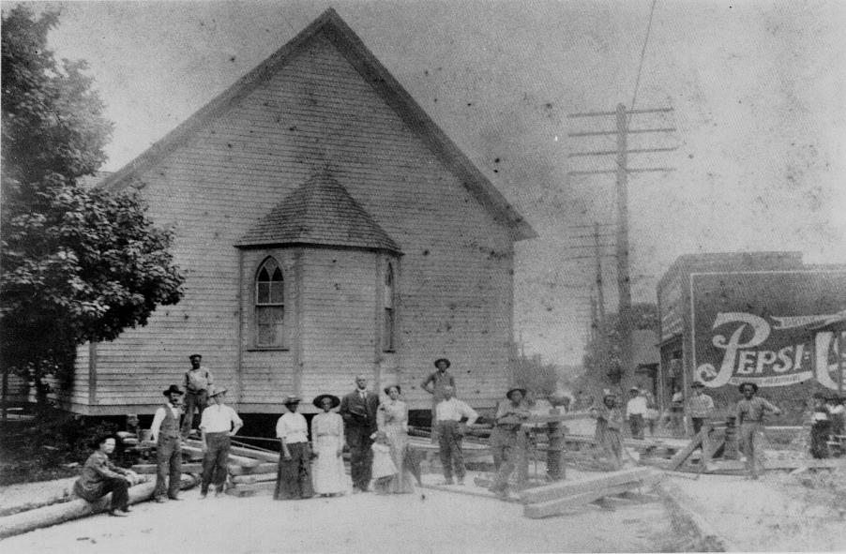

A Digital Map of the Historic West End
Notes:
The James B. Duke Memorial Library is creating a web and mobile app framework for publishing location‐based content including historical photographs, documents, and oral histories that will populate a digital interactive map.
The map documents the Historic West End, a vibrant 150 year old African American community that surrounds the university on the west side of Charlotte, North Carolina and is currently faced with rising gentrification and social change.
This is a model that can be used for others trying to engage the community with archives materials and to inject a historical perspective into the issue of redevelopment, rising housing costs, and gentrification happening across the nation

Slide 27

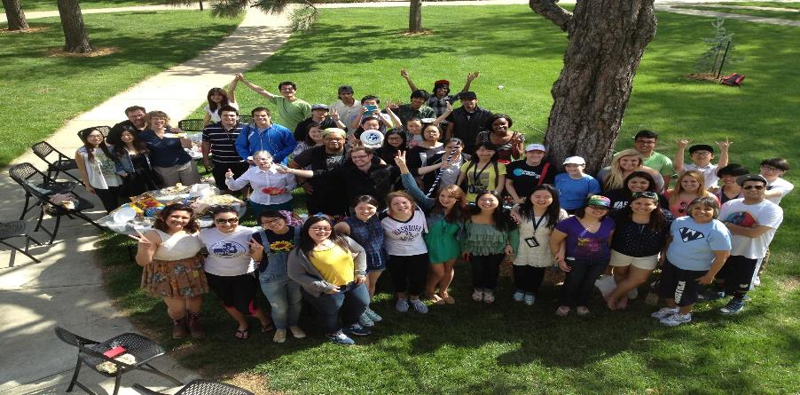
Information Literate to Information Fluent
Notes:
Washburn is creating open source information literacy modules in both English and Spanish, for use by area middle and high school students....
This Access to free online information literacy modules and an accompanying curriculum creates equity in education and will improve critical thinking skills for students at 20 schools in the Northeast Kansas target area.
This project provides a model replicable on a national scale and open access resources created for the project will be adaptable to any classroom curriculum

Slide 28
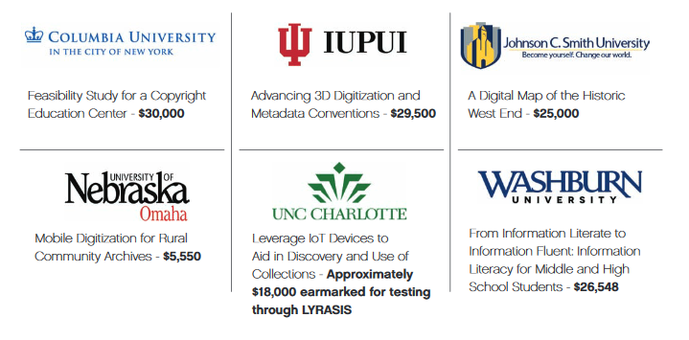
The Catalyst Fund recipients from the first round in 2017
Notes:
2017, we awarded 6 Member Organizations
These represent our first round of recipients and are examples of the variety of projects that came to us last year. You’ll see there is great geographic diversity, institutional size and content—all are quite different from one another and yet show creativity and leadership in many different ways.
The projects will be completed in June and all the models, code, and lessons learned will be available for your use then.
Let’s take a look…

Slide 29
A Fire is More
Than a Spark
A Case Study with Tim Rogers, Director, Jacksonville Public Library

Slide 30
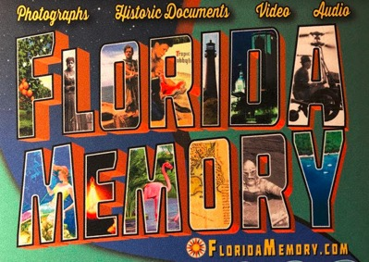
Florida Memory Project
A Case Study with Mark Nicolou, Director at Florida Memory Project

Slide 31
Organizing for Innovation: Staffing, Technology and More
Led by Teddy Gray and Angella Graham, LYRASIS with Tim Rogers, Director of Jacksonville Public Library, Susan Swiatosz, Head of Special Collections and University Archives at the University of North Florida and Scott Bacon, Emerging Technologies Librarian at Coastal Carolina University

Slide 32

Question:
Is technology equated with innovation?

Slide 33

Question:
How do you create an organization that is open to innovation & welcomes change?

Slide 34

Question:
How have you organized your staff to allow for or create capacity for innovation?

Slide 35
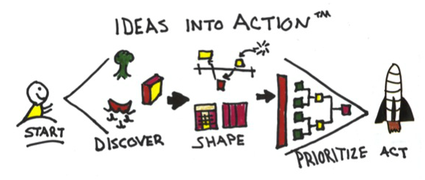
Question:
What services or workflows have you stopped or outsourced in order to give you staff more time to innovate?

Slide 36
Question:
To create an innovative organization, what skills (both hard and soft) do your staff need? What are you looking for in new hires?

Slide 37
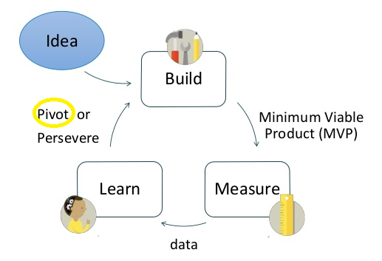
Question:
When an innovative project isn’t working, how do you determine when to walk away?

Slide 38
Question:
From your own experiences, can you tell a story of an attempt to innovate that was successful?
What made that successful? If you had an attempt that wasn’t successful, why didn’t it work?

Slide 39

Question:
How do you get different departments in your organization to reach a common, innovative goal?

Slide 40
Question:
When collaborating with other institutions on innovation, how have you balanced local needs against collective needs?

Slide 41
It Takes a Village: A Framework For Evaluating Sustainability
www.lyrasis.org/itav

Slide 42
Working With Members
Concerns
  Sustainability
  Identifying needs
  Solving problems
Looking for structure or methodology
A recent project provides a framework that may help

Slide 43
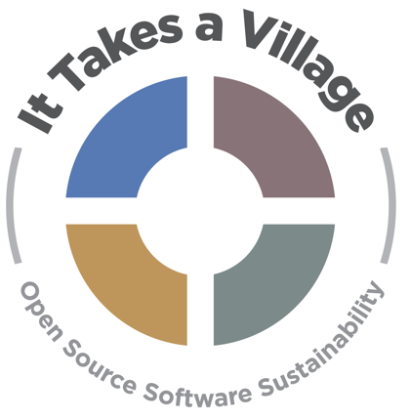

It Takes a Village
This project was made possible in part by the Institute of Museum and Library Services

Slide 44
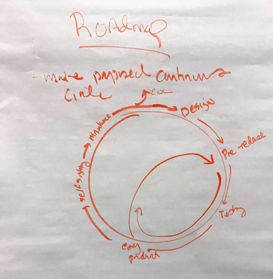
It Takes A Village: Background
OSS programs serving cultural heritage suffer from a lack of resources devoted to sustainability planning
Intended grant outcomes
  Survey, forum, and roadmap/resource allocation guidelines
  Increased awareness of OSS sustainability requirements, variety of models, factors that influence sustainability
  Opportunities for joint projects and collaborations
Notes:
The It Takes a Village project was funded in 2017 by the Institute of Museum and Library Services (IMLS) to bring together open source programs serving cultural and scientific heritage to develop shared sustainability strategies, and to provide our communities with the information needed to assess and contribute to the sustainability of the programs they depend on.
The intended outcomes of the grant were to:
Develop and distribute a survey to a number of OSS programs serving cultural and scientific heritage in order to provide us with a baseline of information about each program’s size, financial health, technology roadmap, and governance;
Hold an in-person forum at which OSS program staff would meet to discuss characteristics and forms of sustainability and factors affecting sustainability;
Create a roadmap that would provide resource and allocation guidelines for each phase of an OSS program’s life cycle.

Slide 45


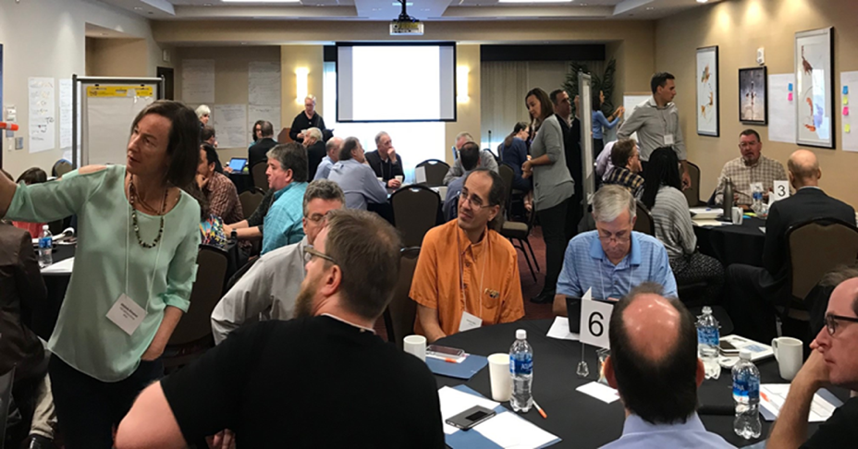
LYRASIS Co Directors
Laurie Gemmill Arp
  Director, CSCSS
Megan Forbes
  Program Manager, CollectionSpace
Advisory Group
Rob Cartolano
  Associate VP for Technology & Preservation - Columbia Libraries
Tom Cramer
  Assistant UL and Director - Digital Library Systems & Services Stanford University
Michele Kimpton
  Director of Business Development, Senior Strategist - DPLA
Katherine Skinner
  Executive Director - Educopia Institute
Ann Baird Whiteside
  Librarian/Asst Dean for IS - Harvard Grad School of Design

Slide 46






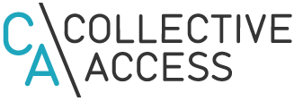







Leaders and Participants
Notes:
Diverse mix of programs and representation

Slide 47






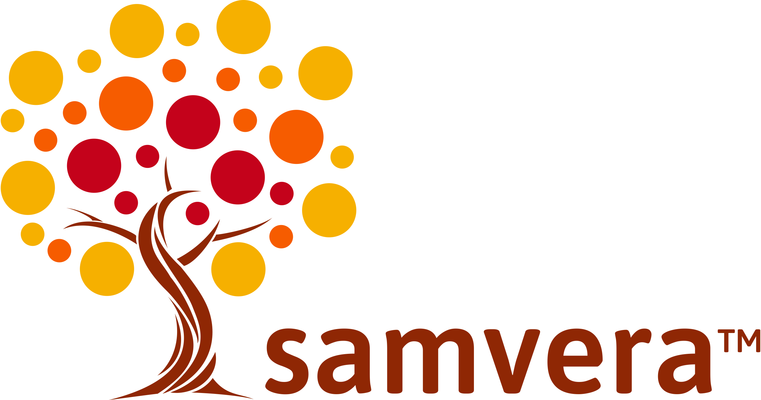







Leaders and Participants

Slide 48
ITAV Background - Survey
Same set of questions for all 27 participating programs
  Governance, audience, roadmap, code committers, implementers, budget, stage, etc.
Expectations
  Find commonalities that we could draw conclusions from, e.g. project of certain size, funding type, license etc. – more likely sustainable
Spoiler – we did not
  Didn’t know them as well as we thought
  Realization that roadmap was unlikely
  Still beneficial - snapshot in time
Notes:
There were a number of surprises in the survey answers, things we thought we knew about projects - such as, Fedora is a big, successful project that has been around for a long time - contrasted with how they answered questions about themselves - again, Fedora feeling like they are in the early stages of adoption. Ole was similar.
We had included a trial framework of different phases in the survey and these responded flagged for us an issue that we needed to discuss in the forum and provided an important core discussion focus.
We quickly realized that coming up with one roadmap with one set of recommendations would neither be possible nor useful for our community. The survey was still useful though, as it gave us a common language to discuss things, and provided us with a snapshot in time for a wide set of projects.

Slide 49
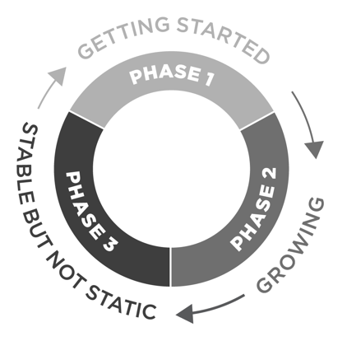
ITAV: Major Findings
Community – needs
Sustainability is not one thing, nor is it a straight line
Sustainability has facets that move in cyclical phases - together and separately
Gathered information from survey and forum to develop a Guidebook to serve as a practical reference source for OSS programs

Slide 50
Program Sustainability in Libraries, Archives, and Museums
How many have been involved with programs such as:
  Technology program
  Public program
  Consortia / professional organization
Are they all still around?
  If not, do you know why not?
Have you ever evaluated a program’s sustainability before participating or using at your institution?
  How did you evaluate it?
  What factors were the most critical?

Slide 51
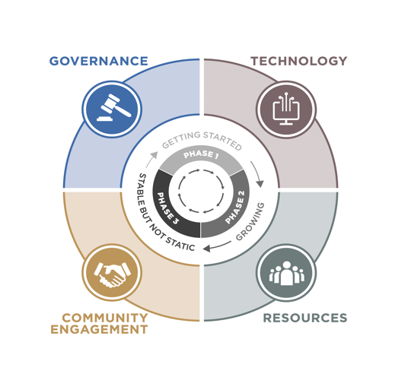
ITAV: Facets
Governance
Technology
Resources
Community Engagement

Slide 52
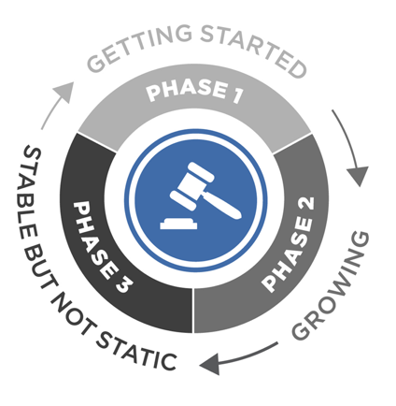
Facet: Governance – How Are Decisions Made?
Characteristics
  Establishing: Working with original staff/organization
  Stabilizing: Functional but limited in one or more aspects
  Evolving: Strong management structures, although not all have formal governance
Questions to ask?
Notes:
Overall, I think of governance as how decisions get made.
Governance describes the roles that participants take on, and the process for strategic and tactical decision making. It also describes the ground rules for participation in the project.
Phase I programs are establishing governance - they are often working with the original software engineers, project staff, or founding organization. The core goal - to plan and implement the governance model that best reflects the values of the program and community.
Phase II programs are stabilizing governance. A governance structure exists, but it may be limited in one or more aspects. The core goal -is evaluate existing governance structures to identify strengths and weaknesses, and determine whether the program’s growing needs are supported.
Phase III programs are evolving governance. Strong management structures are in place, but there is “just enough” governance in place to keep the program on a steady path.
Seed questions: Is there enough, too much, are the roles/responsibilities clear? Do we understand how to communicate, contribute, join the community?

Slide 53
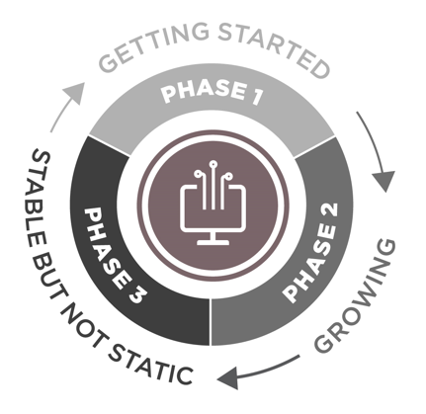
Facet: Technology – Core?
Characteristics
  Laying the groundwork: Design, pre- or early beta release
  Expanding and integrating: Have a formal release process and being used outside the founding orgs
  Preparing for change: Strong but looking forward to next generation
Questions to ask?
Notes:
Technology may or may not be core to the program.
Phase I - in design, pre-release, or the early beta testing phase. They may have no implementations, or a small set. The core goal -turn an idea into a viable product that serves the needs of the community.
Phase II - more than one public release, formal release process, generally adding new features and functionality to the application. The core goal - refine application by amplifying things that are working well and phase out less successful.
Phase III - in production, well-adopted and supported. The technology stack stable, and programs may be looking to update to next generation technologies. The core goal - determine how the technology stack will serve the future needs, and plan ahead for expansion, integration, or re-architecture.
Seed questions: Is there a tech roadmap? how often updated? Who’s making decisions about new functionality? Is all development done by the program? Infrastructure to support members contributing code? Are integrations being considered? Is there a long term plan for changes?

Slide 54
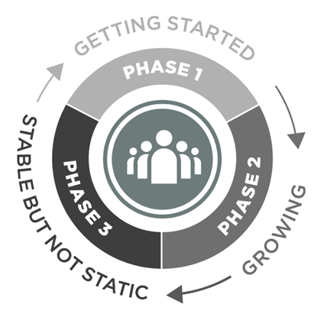
Facet: Resources – Human and Fiscal
Characteristics
  Creating consistency: Typically single owner or champion
  Diversification: Distributed resourcing
  Stable but not Static: Diverse support and income streams – focused on long range strategy
Questions to ask?
Notes:
In order to launch, grow, and thrive, programs need resources both human and fiscal. Human resources encompass engineers writing code, community members providing use cases, or organ homes with fiscal stewardship. Financial resources come in and go out in a wide variety of ways – in via contributions, grants, dues, sponsorships, etc., and out via salaries, and overhead.
Phase I-usually funded by a single organization, grant-funded, or volunteer operated. The core goal -create a sustainability plan that will provide a consistent and sustained level of resources.
Phase II - more distributed resourcing, but have a small number of revenue streams. The core goal -diversify income streams and talent pools to mitigate reliance on 1 source of income or member.
Phase III - diverse staff support/income streams -more focused on long-range strategy. The core goal - resilience, ensuring that they can continue to evolve to meet the community’s needs.
Seed questions: Is there a strategy to get beyond grant funding. Are more than core stakeholders contributing? succession plan? Where they are housed – e.g. university, home org, etc. Is that a long-term solution?

Slide 55
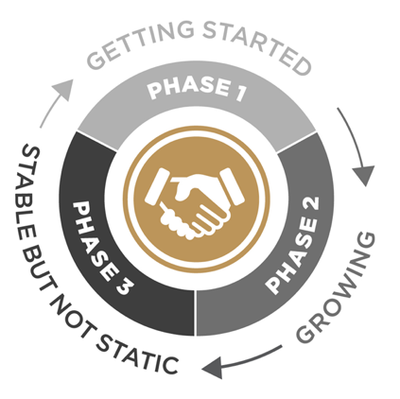
Facet: Community Engagement – Users → Stakeholders
Characteristics
  Getting beyond initial stakeholders: Lack of engagement with broader community
  Establishing infrastructure: Enable engagement
  Evolving: Well-established infrastructure – variety of opportunities
Questions to ask?
Notes:
The CE facet reflects efforts to facilitate and foster involvement within a community. It is focused on encouraging users to become stakeholders. Those who have a sense of investment and ownership become champions who want the program to grow and succeed.
Phase I - focused on their primary stakeholders, and often have a lack of engagement with the broader community. The core goal - is to identify and involve a wider group of stakeholders.
Phase II - working to determine how to facilitate engagement that works best for their community. The core goal - to bring more community members into the folder, turning users into stakeholders.
Phase III - have an established infrastructure to enable engagement. The core goal - continue to evaluate and evolve the engagement model to keep up with new technologies, communities, and collaborators.
Seed questions: Is the program regularly communicating out? Is it easy to find information, updates, users, program team members? Do community members encouraged to contribute to communications – write blog posts, make presentations? Diversity of engaged participants or do they all “look” the same – e.g. all R1.

Slide 56
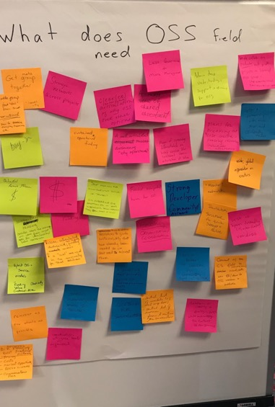
Next Steps
Useful for YOU?

Slide 57
Library Simplified
an emerging digital content platform built by and for libraries

Slide 58
The vision
Return ownership/control of the patron ebook experience back to library
Increase literacy by simplifying the patron experience, lowering barriers to content access
Reduce vendor lock-in by creating a platform owned/driven by public libraries
Better understand your environment, make more informed decisions, with trends/data on patrons and their usage

Slide 59
The partners
Library staff control the presentation of collections to patrons via the Circulation Manager (hosted by LYRASIS)
All library digital content is two taps away via the SimplyE mobile apps (supported by NYPL)
Digital content can be sourced from a library-driven marketplace via the DPLA Exchange (from DPLA)
All three institutions are mission-driven non-profits committed to reinvesting back into the future

Slide 60

The platform
Content Feeds (OverDrive and Open Access)
Content Purchase / Curation
(DPLA Exchange)
Circulation Manager
(LYR)
Topeka Library Catalog
(Polaris)
Consol. E-book catalog
SimplyE
App
patron
E-book transactions
Search/browse
Check out/in

Slide 61
The project
Your branding: Patron interacts directly with your library (not the vendor)
Ease of Use: Consolidates all e-book content into a single access point for patrons
Content: Provides OA ebooks plus a web portal for your curated purchases
Minimal risk: Used along side current ebook platforms
If a vendor’s platform goes down, most patron transactions are not affected
________________________________________________
Driven by a growing national community and its ongoing conversation
You can be in “on the ground floor” - an integral part of the dialogue

Slide 62
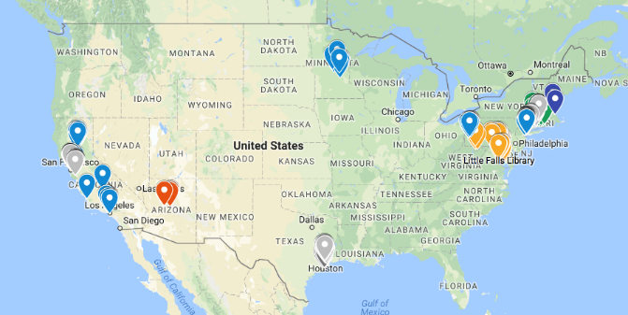
The community

Slide 63
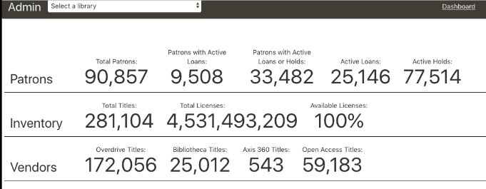
Powerful tools at scale (NYPL dashboard)

