Slide 1
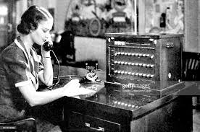
Experiments in Innovation
LYRASIS Leaders Forum #21
Richmond, VA – March 29, 2018
by Robert Miller and Lisa Larson
Notes:
350,000 at ATT in the 1940’s
NYPL – David Ferrio

Slide 2
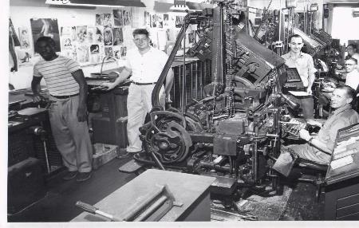
Experiments in Innovation
LYRASIS Leaders Forum #21
Richmond, VA – March 29, 2018
by Robert Miller and Lisa Larson
Notes:
125 years…
Industry wiped out – crt

Slide 3
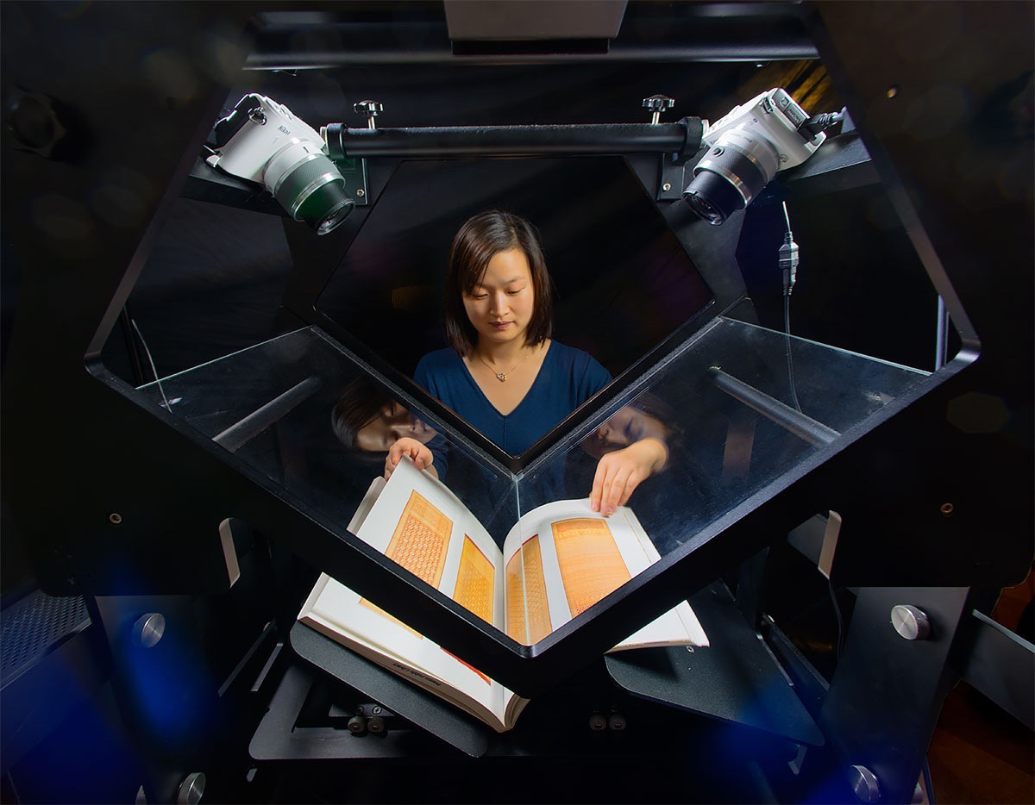
Experiments in Innovation
LYRASIS Leaders Forum #21
Richmond, VA – March 29, 2018
by Robert Miller and Lisa Larson
Notes:
Impact and Innovation –
Why are we here?

Slide 4

Experiments in Innovation
LYRASIS Leaders Forum #21
Richmond, VA – March 29, 2018
by Robert Miller and Lisa Larson
Notes:
Impact and Innovation –
Why are we here?

Slide 5

Innovation with a small ” i “ …mostly transactional
Culture change...
What did we start with? Lots of project-level innovation last 2+ years
Most were incremental, focused on Operational Effectiveness
  Intra-departments - re-align for better trained staff
  Inter-departments - divisional opportunities
  Services – cut prices, follow up
  Response time– automated transactions, new version, more capability
  Value – began to think about what you needed
And some didn’t turn out exactly as planned ☺
  Hosted ILS service - launched, then discontinued Evergreen
  Member Snapshot – struggled to get it out. Too long to deliver
Looked into the mirror
Operational improvement is not a strategy for getting to the next level…

Slide 6

Mission > Goal > Objective > Strategy>tactics
Mission – Why do our members want us to exist?
Goal – What do you want us to be?
Objective – Where do we need to get to?
Strategy – How? Through Innovation and Impact
Tactics – What’s of the Strategy
Notes:
How many of you have foundation documents?
Mission, Vision and Values?
LYRASIS supports enduring access to our shared academic, scientific and cultural heritage through leadership in open technologies, content ​services, digital solutions and collaboration with archives, libraries, museums and knowledge communities worldwide.
Goal – to be one of the three organizations you rely on to remain relevant. This means we want to assist you to punch above your weight, participate in regional, superregional, national and international discussions, and also show case your local success.
Objective – Create a methodology to have two way conversations with our key members. that result in sustainable solutions that have broad impact.
Strategy – LC>LF>C$F

Slide 7

Expanding Our View – Innovation with a capital “ I ”
Pivot toward Innovation as a Strategy
Innovation (with a capital “I”)
External –
  Establish an Innovation Process to create a membership advantage … LC>LF>C$F
  Separate ourselves from marketplace/competitive convergence
  We believe we are VERY different from other “similar” consortia
Internal –
  Team work, not work teams – front line staff paired with mentors (mgt)
  Act/Launch instead of React/Crawl
  Darwinian improvement, not just replication
  Integrated funding strategies – seed> milestone driven> foundation>sustainability
  Accountability – when to act like a missionary, when to act like an entrepreneur
Notes:
ROBERT We’ve Achieved $1 in the Black ……
which of course is great; provides bandwidth and financial resources for growth
BUT ……
Operational Effectiveness is NOT a strategy for getting to the next level
Internally focused
Doesn’t address market changes and shifting member needs
Not a significant market differentiator

Slide 8
The Innovation Question
?
How does a non-profit, member-based organization launch “Innovation” as a strategic business initiative, assuming its inherent risks,
to sustain and grow as an organization,
on behalf of its members?
Notes:
LISA. Operational effectiveness means doing similar activities as similar organizations (consortia) better and with less defects. This is foundational: As Robert suggests, an organization cannot be strategic or innovative, if they haven't solved the riddle of being effective as an operation. But I suggest this is not strategic. STRATEGY requires trade offs, where Operational effectiveness does not. TRADE OFFS create need for CHOICE. The LYRASIS path to INNOVATION with a Big I is our structure for CHOOSING. If you try to be all things to all members, or customers or clients – the mission begins to lose clarity, value props are lost and we don't know who or what we are.

Slide 9
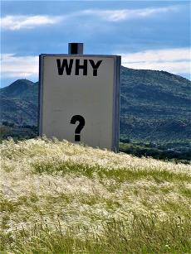
Why LYRASIS? Why the Need? How do we Manage Innovation?
The Market
  Environment and opportunity is constantly evolving
  Limited resources to explore, test, fail, succeed
  Consortia approaching competitive convergence: danger
Why LYRASIS?
  We've achieved a repeatable operational effectiveness
    Allows us to think along the frontier – go to the edge
  We are prepared to Lead "from the front"
    We have the platform and distribution channels
    We have the up and downstream relationships
    We have a nationwide multi-type membership compelling us to think about unique needs that may impact all
  We are financial stable
    Has allowed us to enter into a culture of risk taking on behalf of membership
  We are strong and diverse in our employee and member base
    A member in every State
    Employees based across the country
How to balance Operational Effectiveness and Innovation as a Strategy?
Notes:
(LISA) Does your organization operate in a risk averse culture? We'll get back to that, but think about that question.
(to frame this in context with historical roles of consortia and to emphasize how we're different) At the Why LYRASIS bullet:
The wave of consortia consolidation, through mergers was driven by performance measures, not strategic vision. There is a real danger of diminishing returns if an organization is focused solely on performance. If an organization strives for continuous improvement and benchmarking, it can unwittingly be drawn towards homogeneity with other organizations. The more similar they become (competitive convergence) DO YOU WANT TO STAND OUT? Let's get back to that.
WHY LYRASIS? Lisa – quick story about why I'm here. Academic publishing was all short term financial and product distribution goals. Long term impact or achievement wasn't part of the picture. I wanted that.

Slide 10
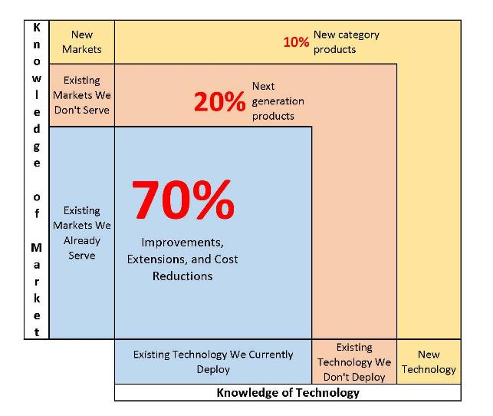
The 70/20/10 Rule
Knowledge of Technology and Market
Notes:
(LISA) LYRASIS has 2 personas
Leaders in Content
Leaders in Convening the Communities
Hurdles to overcome with both having a process and having the right technology
If you are a leader in your organization and you are fearless, you are likely in the 20%. A partnership might enable you to get into the 10% w/o impacting your staff. We are modeling our organization to be the COO to your CEO in order to allow our members to get into the frontier without threatening your need for organizational stability and efficiency. This is how we are becoming a consortium like no other – in the traditional sense.

Slide 11
Highlight of One ”Above the Line" Project
LYRASIS Learning
PAST
  Good reputation for professional development
  A la carte model (competitive convergence)
  Expensive to develop, grow and maintain: unpredictable revenue stream
NEW VALUE
  Easier to budget and plan
    Predictable for the library, predictable for LYRASIS
  Expand access to classes to all staffers on demand
Strategic?
  Differentiates from marketplace
  Allows us to expand our relationships and partnerships for future growth
  Allows test/try of other open source technologies (avalon, future open source LMS)
Notes:
(LISA)

Slide 12
Pivots & Innovation
LYRASIS Leaders’ Forum, Richmond, VA
Elizabeth Gail McClenney
March 29, 2018

Slide 13
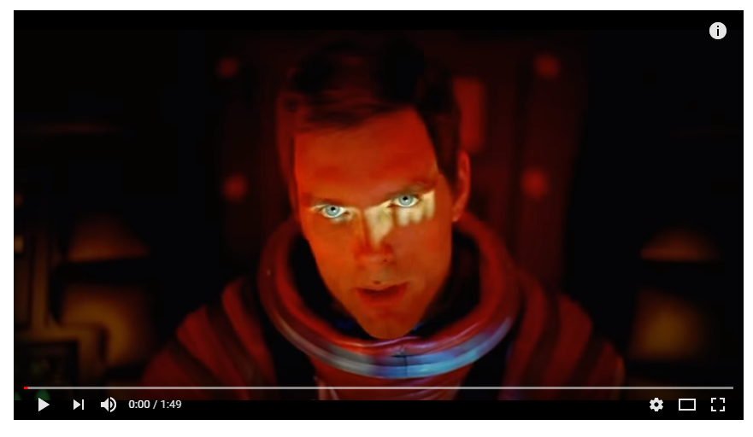
An Odyssey …

Slide 14
Our Context …
Pivot – “a person, thing, or factor having a major or central role, function, or effect”
Disruption – “ to interrupt the normal course or unity of”
Innovation – “the introduction of something new”
Notes:
All from Merriam Webster

Slide 15
Disruptive Technology
“Sustaining technology relies on incremental improvements to an already established technology. Disruptive technology lacks refinement, often has performance problems because it is new, appeals to a limited audience and may not yet have a proven practical application.” (Christensen,1997)
Notes:
What in our own environments might we have called a disruptive technology?

Slide 16
Disruptive Strategic Innovation
“Strategic innovation means an innovation in one’s business model that leads to a new way of playing the game. Disruptive strategic innovation is a specific type of strategic innovation —namely, a way of playing the game that is both different from and in conflict with the traditional way. Examples include Internet banking, low-cost airlines, direct insurance, online brokerage trading, online distribution of news and home delivery of grocery services.”
MIT Sloan Management Review, Winter 2003: https://sloanreview.mit.edu/article/responses-to-disruptive-strategic-innovation/

Slide 17
Familiar pivots…
Journal Prices / Big Deals
Wireless in Barnes & Noble / Walmart
Textbook Costs
Unused / Hidden Resources
Community Needs
Notes:
Our Pivot Points
Internet of Things

Slide 18
Familiar Disruptors
  Scholarly Communication
  Open Access
  Open Source
  Open Education Resources (Z-Degrees)
  Library Cafés
  Evidence Based Acquisitions
  Digitization
  Crowd-sourced transcription
  Job Seeker Assistance (RVALibraries)
  Homework Centers w/ nutritional programs

Slide 19
PIVOT SOLINET to LYRASIS
Historically LYRASIS (ne SOLINET) was (and still is) all about high touch
  It was known as the comfortable partner. Relationships were personal. LYRASIS is still high touch; today however, the questions LYRASIS staff ask are not just only what LYRASIS can do for you, but how can it help your institution. What solutions do you need addressed?
  Prior to my arrival on the board in 2013, LYRASIS had begun its pivot to deliberately address digital technology services and the needs that members had in finding solutions in this arena.
  There was also a deliberate shift in its mission statement to ensure that all members saw themselves represented (libraries, museums, archives, and cultural heritage organizations).
LYRASIS now is the perfect place for innovation & impact.
  During the Leaders’ Circle meeting we consistently heard about
    Community
    Connections
    Collaboration
    Service
  As I spoke with members they saw that LYRASIS was actively providing ROI through
    Leaders Circle
    Leaders Forum
    Membership Summits
    Catalyst Fund -- member ideas supported and funded and will eventually benefit the whole
  Each of these aforementioned areas leads to Innovation & Impact

Slide 20
Lyrasis’ Pivot
Before 2013
  Transaction-based
  Personal relationships
  Training & consultation
2013
  Digital technology services
  Finding & proposing solutions
  Institutionalized value
  Purposeful inclusion
2018
  Strategic relationships
  Member ROI
  Intersection of innovation & impact

Slide 21
Disruption
Change

Slide 22
Change
Innovation

Slide 23
Catalyst Fund: Recipients and Next Steps
Tweet #lyrasis
Meaningful Dialogue | Thought Leadership | $100,000 to Fund New Ideas | Ideation Sandbox

Slide 24

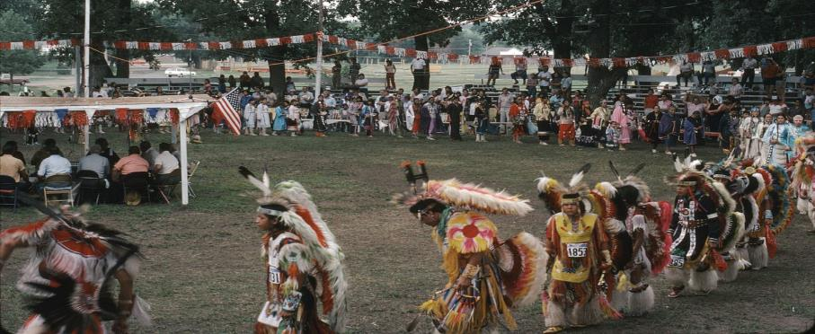
Mobile Digitization for Rural Archives
Working with tribal colleges and communities in Nebraska
Notes:
In recent years, archivists have identified the need and desire to capture community archives materials—those that are not deposited at an institution, but rather remain in family or community collections. The University of NE, Omaha project is exploring the use of a mobile maker space and digitization lab that allows the organization to reach out to rural communities and digitize their material, making such material widely available while keeping the archive in the community.
They have received matching funds that doubled the project budget from the University
Their white paper will talk about how to apply this in other rural states
Mobile labs have been used before, but only in urban areas, and never with tribal members

Slide 25

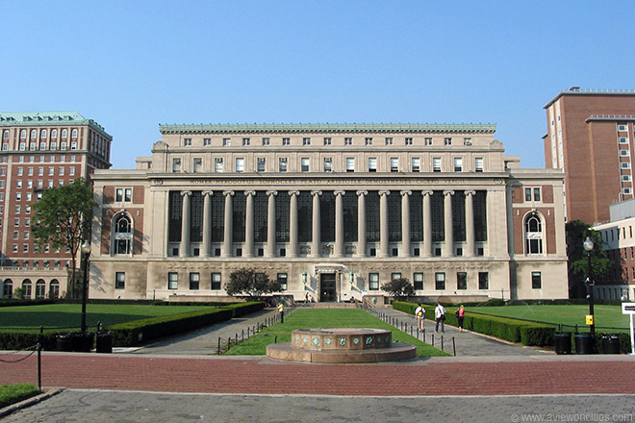
Feasibility study for Copyright Education Center
Notes:
The Catalyst fund was used to scope out the potential for a multi-partner approach to professional development education.
The outcome of the LYRASIS grant clarified potential and a road forward. In addition, Columbia has already modeled another project that is unrelated on the same collaborative approach.
They are now moving to detailed business planning and then implementation
Look for updated copyright education classes for the field coming next.

Slide 26

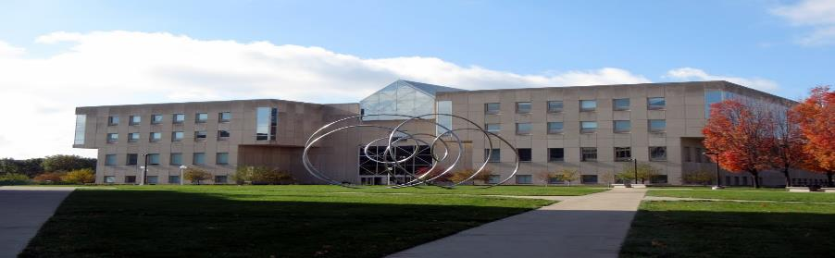
Advancing 3D digitization and Metadata Conventions
To move towards standards for scanned 3D artifacts
Notes:
National* and international** surveys have been conducted regarding the use of 3D imaging and user requirements in cultural heritage institutions. Based on survey results, utilizing 3D technologies in libraries, museums and archives is in its infancy.
The survey’s points towards usage possibilities (ability to remotely measure true size of objects) and desired user requirements (easy online viewing and navigation) yet there was no comprehensive understanding of what constitutes 3D image quality and description for exchange, preservation, and access of digital artifacts.
This project will vett those standards nationally—and museums, archaeology and anthropology collections, galleries and others with 3D works will be able to implement these standards with their own collections…
*(Urban, 2015)
**(Hess, 2015)

Slide 27


Leverage IOT Devices to discover Collections
Notes:
leverage IOT devices to aid our patrons in discovery and use of our library and its systems
A few examples are as follows:
Amazon Alexa device to connect to library systems using voice (improve accessibility). They are now building the connectors to library technology that others could leverage.
And creation of IOT button technology to gain location based assistance
In October, the pilot had just started and already other areas on campus wanted to use the technology for other things such as, using it to book study rooms or appointments in the counseling and career centers…

Slide 28
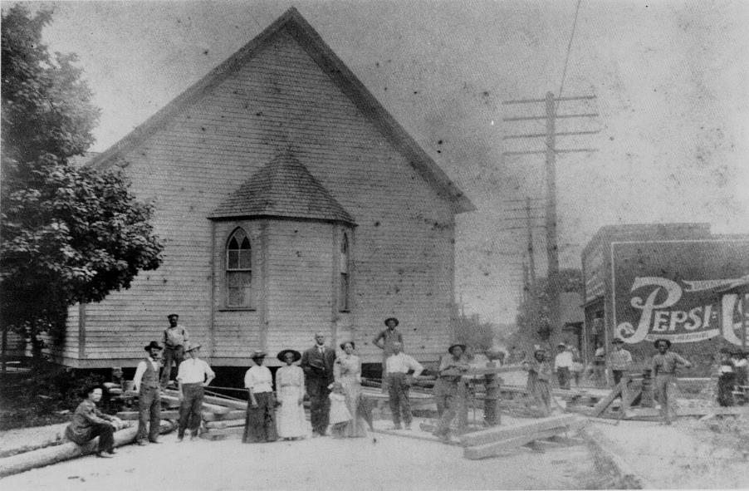

A Digital Map of the Historic West End
Notes:
The James B. Duke Memorial Library is creating a web and mobile app framework for publishing location‐based content including historical photographs, documents, and oral histories that will populate a digital interactive map.
The map documents the Historic West End, a vibrant 150 year old African American community that surrounds the university on the west side of Charlotte, North Carolina and is currently faced with rising gentrification and social change.
This is a model that can be used for others trying to engage the community with archives materials and to inject a historical perspective into the issue of redevelopment, rising housing costs, and gentrification happening across the nation

Slide 29

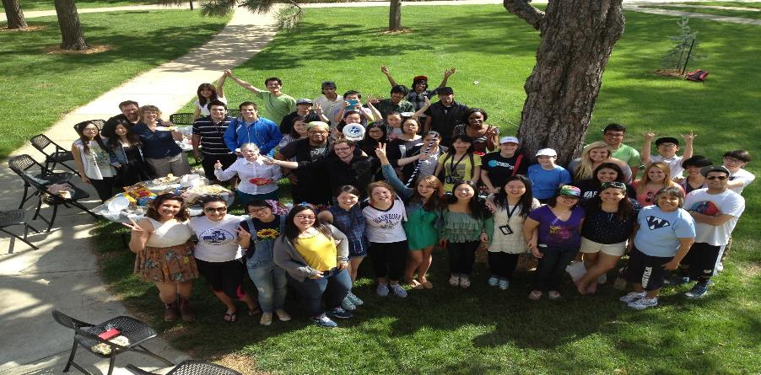
Information Literate to Information Fluent
Notes:
Washburn is creating open source information literacy modules in both English and Spanish, for use by area middle and high school students....
This Access to free online information literacy modules and an accompanying curriculum creates equity in education and will improve critical thinking skills for students at 20 schools in the Northeast Kansas target area.
This project provides a model replicable on a national scale and open access resources created for the project will be adaptable to any classroom curriculum

Slide 30
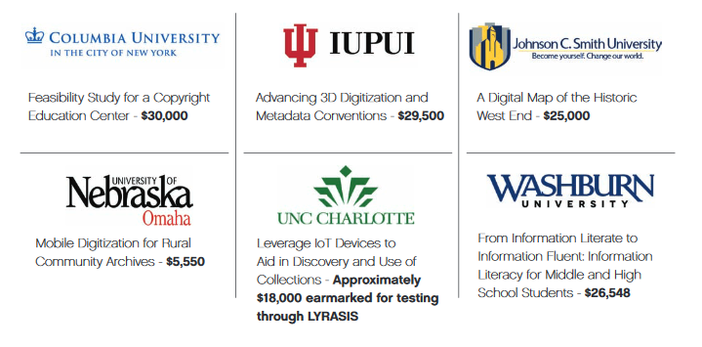
The Catalyst Fund recipients from the first round in 2017
Notes:
2017, we awarded 6 Member Organizations
These represent our first round of recipients and are examples of the variety of projects that came to us last year. You’ll see there is great geographic diversity, institutional size and content—all are quite different from one another and yet show creativity and leadership in many different ways.
The projects will be completed in June and all the models, code, and lessons learned will be available for your use then.
Let’s take a look…

Slide 31

We Have a Pipeline of Projects Underway
Product Development Pipeline
Above the green line…
  Disaster Readiness ready for market
  ORCID ready for market
  LYR Learning pilot done
  SimplyE pilot done
  Publics / Academics
  Below the green line…
  Museum Connect pivot
  End2End Soln concept
  Fiscal Solutions concept
  Future Proofing testing
Notes:
ROBERT slide – to replace with C$F take aways

Slide 32

Robert C$F fund slide
Notes:
Just tuck a picture on here somewhere that has to do with impact or innovation

Slide 33

Discussion or Panel Questions
Does your organization work in a risk averse environment?
Do you have the bandwidth, the leverage and administrative buy in to be strategic?
Is LYRASIS’ commitment to Innovation more or less than what you’d expect?
  Are you aware of any other consortia who are engaging in this way with and on behalf of their members?
  Is this different, similar or better than what other membership orgs are doing?
Do you have similar examples of strong innovation at your own institution?
  Or other initiatives too challenging to be addressed/tackled?
Are we telling this story correctly? Does this resonate with you?
Notes:
Sam – picture, we can smoosh the text
(LISA) – work with jenn to add in questions for the panel discussion

Slide 34
please contact us for more info.
Phone 800.999.8558
Email robert.miller@lyrasis.org
Email lisa.larson@lyrasis.org
wearelyrasis
lyrasis
By Robert Miller and Lisa Larson

