Slide 1
It Takes a Village: A Framework For Evaluating Sustainability
by Laurie Gemmill Arp
LYRASIS, Director, Collections Services & Community Supported Software
www.lyrasis.org/itav

Slide 2
Working With Members
Concerns
  Sustainability
  Identifying needs
  Solving problems
  Helping members make good choices
Looking for structure or methodology
A recent project provides a framework that may help

Slide 3


It Takes a Village
This project was made possible in part by the Institute of Museum and Library Services

Slide 4
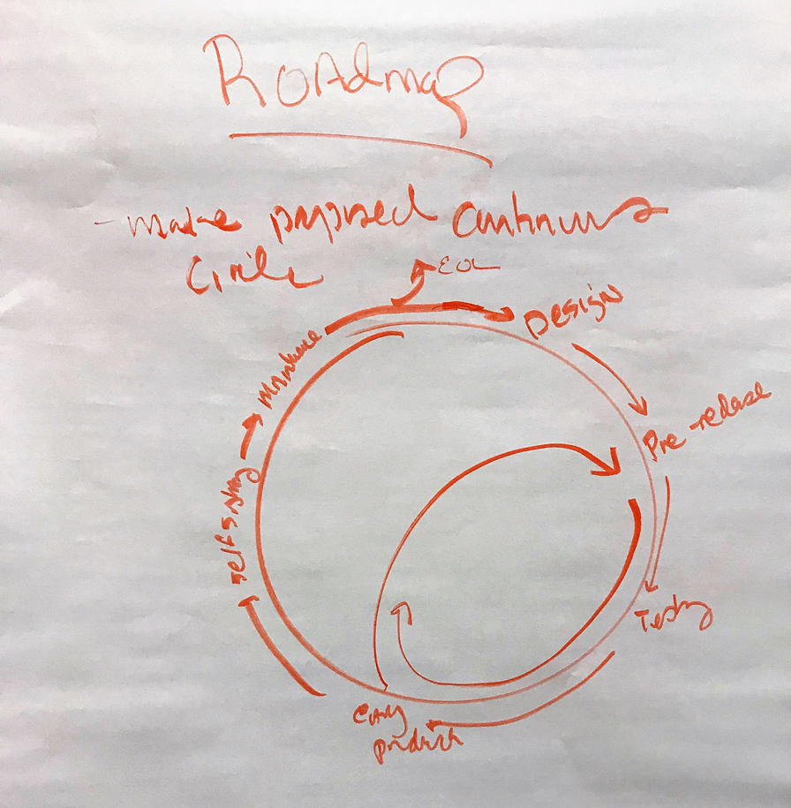
It Takes A Village: Background
OSS programs serving cultural heritage suffer from a lack of resources devoted to sustainability planning
IMLS funded in 2017
Intended grant outcomes
  Survey, forum, and roadmap/resource allocation guidelines
  Increased awareness of OSS sustainability requirements, variety of models, factors that influence sustainability
  Opportunities for joint projects and collaborations
Notes:
The It Takes a Village project was funded in 2017 by the Institute of Museum and Library Services (IMLS) to bring together open source programs serving cultural and scientific heritage to develop shared sustainability strategies, and to provide our communities with the information needed to assess and contribute to the sustainability of the programs they depend on.
The intended outcomes of the grant were to:
Develop and distribute a survey to a number of OSS programs serving cultural and scientific heritage in order to provide us with a baseline of information about each program’s size, financial health, technology roadmap, and governance;
Hold an in-person forum at which OSS program staff would meet to discuss characteristics and forms of sustainability and factors affecting sustainability;
Create a roadmap that would provide resource and allocation guidelines for each phase of an OSS program’s life cycle.

Slide 5


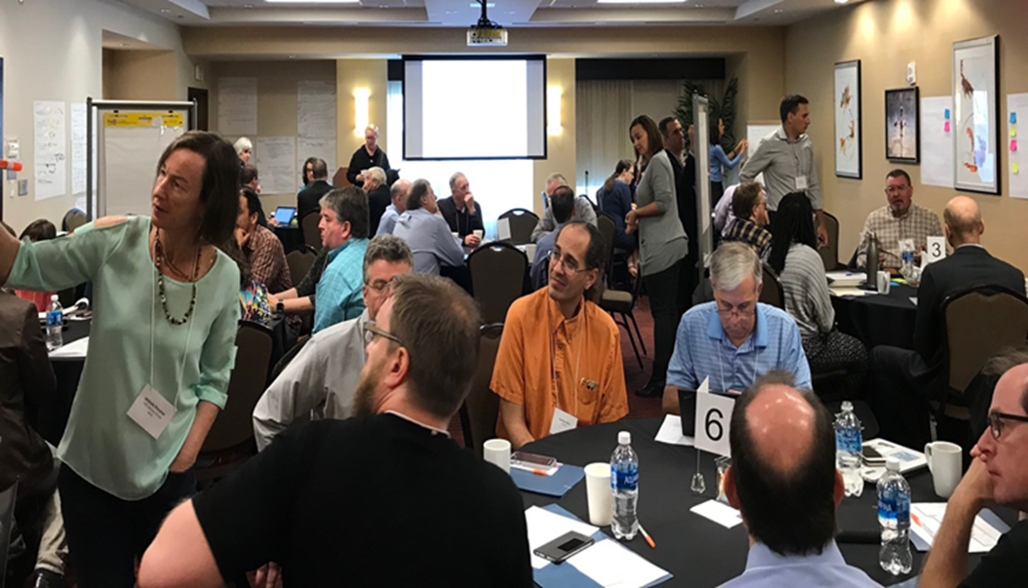
LYRASIS Co Directors
Laurie Gemmill Arp
  Director, CSCSS
Megan Forbes
  Program Manager, CollectionSpace
Advisory Group
Rob Cartolano
  Associate VP for Technology & Preservation - Columbia Libraries
Tom Cramer
  Assistant UL and Director - Digital Library Systems & Services Stanford University
Michele Kimpton
  Director of Business Development, Senior Strategist - DPLA
Katherine Skinner
  Executive Director - Educopia Institute
Ann Baird Whiteside
  Librarian/Asst Dean for IS - Harvard Grad School of Design

Slide 6














Leaders and Participants
Notes:
Diverse mix of programs and representation

Slide 7














Leaders and Participants

Slide 8
ITAV Background - Survey
Same set of questions for all 27 participating programs
  Governance, audience, roadmap, code committers, implementers, budget, stage, etc.
Expectations
  Find commonalities that we could draw conclusions from, e.g. project of certain size, funding type, license etc. – more likely sustainable
Spoiler – we did not
  Didn’t know them as well as we thought
  Realization that roadmap was unlikely
  Still beneficial - snapshot in time
Notes:
There were a number of surprises in the survey answers, things we thought we knew about projects - such as, Fedora is a big, successful project that has been around for a long time - contrasted with how they answered questions about themselves - again, Fedora feeling like they are in the early stages of adoption. Ole was similar.
We had included a trial framework of different phases in the survey and these responded flagged for us an issue that we needed to discuss in the forum and provided an important core discussion focus.
We quickly realized that coming up with one roadmap with one set of recommendations would neither be possible nor useful for our community. The survey was still useful though, as it gave us a common language to discuss things, and provided us with a snapshot in time for a wide set of projects.

Slide 9
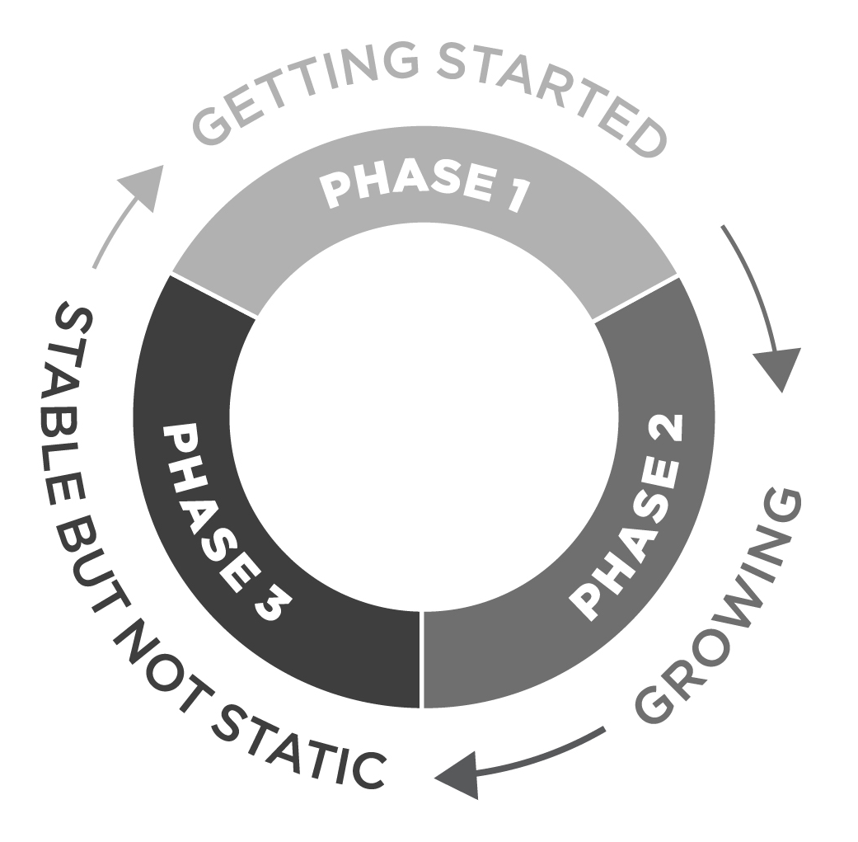
ITAV: Major Findings
Sustainability is not one thing, nor is it a straight line
Community – needs
Sustainability has facets that move in cyclical phases - together and separately
Gathered information from survey and forum to develop a Guidebook to serve as a practical reference source for OSS programs
We identified a framework for sustainability

Slide 10
Program Sustainability in Libraries, Archives, and Museums
How many have been involved with programs such as:
  Technology program
    Open source/proprietary
  Public program
    Book festivals/speaker series
  Consortia/professional organization
    New Media Consortium/Horizon Report
Are they all still around?
  If not, do you know why not?
Have you ever evaluated a program’s sustainability before participating or using at your institution?
  How did you evaluate it?
  What factors were the most critical?

Slide 11
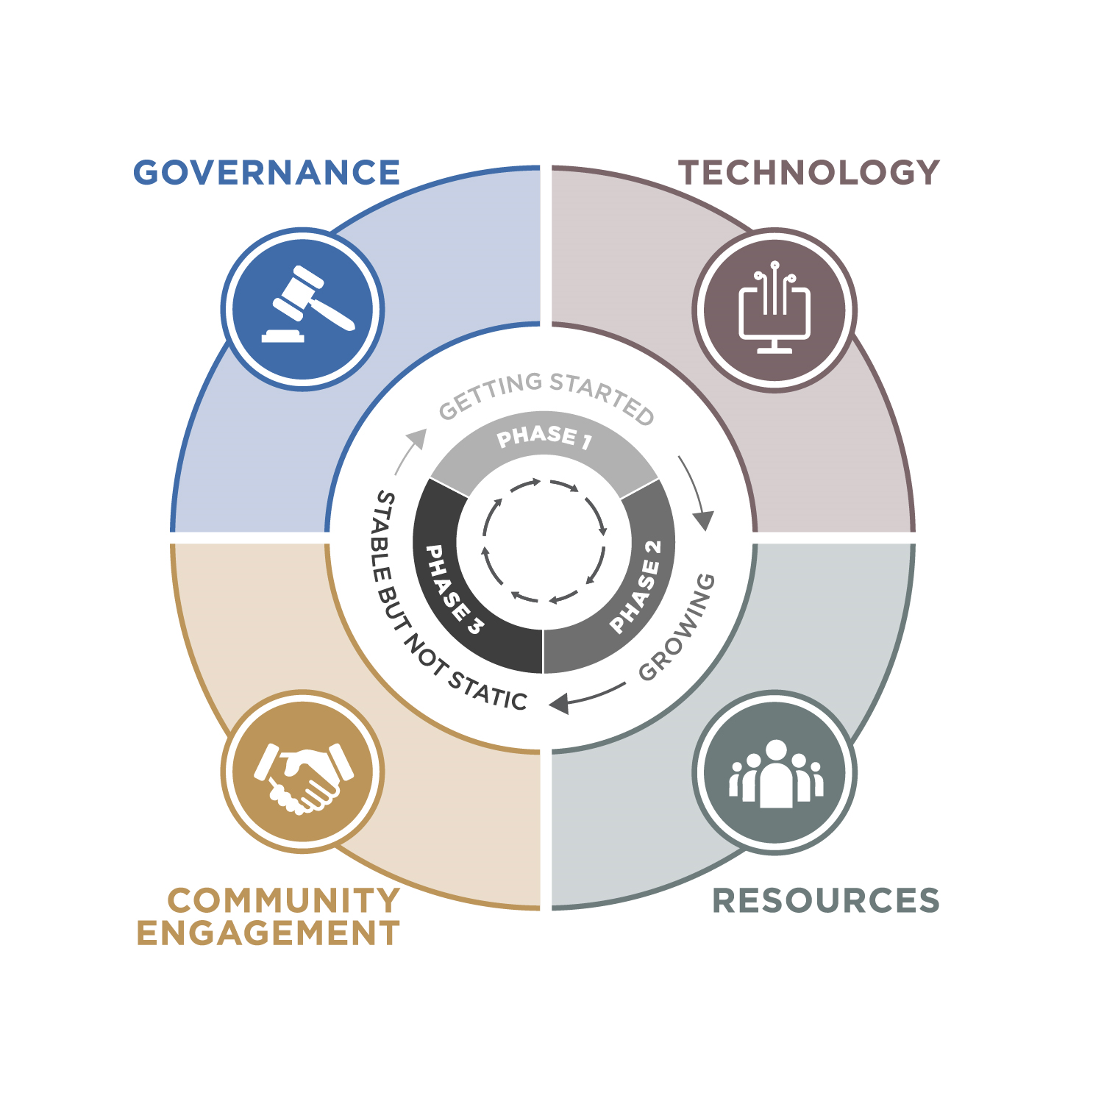
ITAV: Facets
Governance
Technology
Resources
Community Engagement

Slide 12
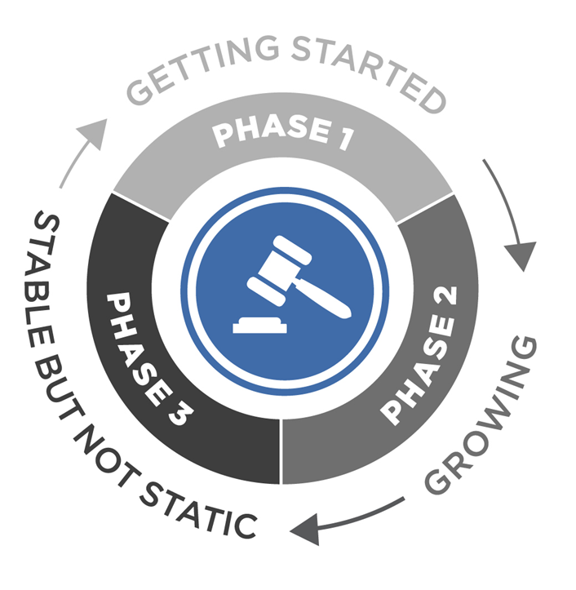
Facet: Governance – How Are Decisions Made?
Characteristics
  Establishing: Working with original staff/organization
  Stabilizing: Functional but limited in one or more aspects
  Evolving: Strong management structures, although not all have formal governance
How do you evaluate?
Questions to ask?
Notes:
Overall, I think of governance as how decisions get made.
Governance describes the roles that participants take on, and the process for strategic and tactical decision making. It also describes the ground rules for participation in the project.
Phase I programs are establishing governance - they are often working with the original software engineers, project staff, or founding organization. The core goal - to plan and implement the governance model that best reflects the values of the program and community.
Phase II programs are stabilizing governance. A governance structure exists, but it may be limited in one or more aspects. The core goal -is evaluate existing governance structures to identify strengths and weaknesses, and determine whether the program’s growing needs are supported.
Phase III programs are evolving governance. Strong management structures are in place, but there is “just enough” governance in place to keep the program on a steady path.
Evaluate?
Seed suggestions: Clearly define the needs, evaluate different models, evaluate and evolve.
Questions:
Seed questions: Is there enough, too much, are the roles/responsibilities clear? Do we understand how to communicate, contribute, join the community?

Slide 13
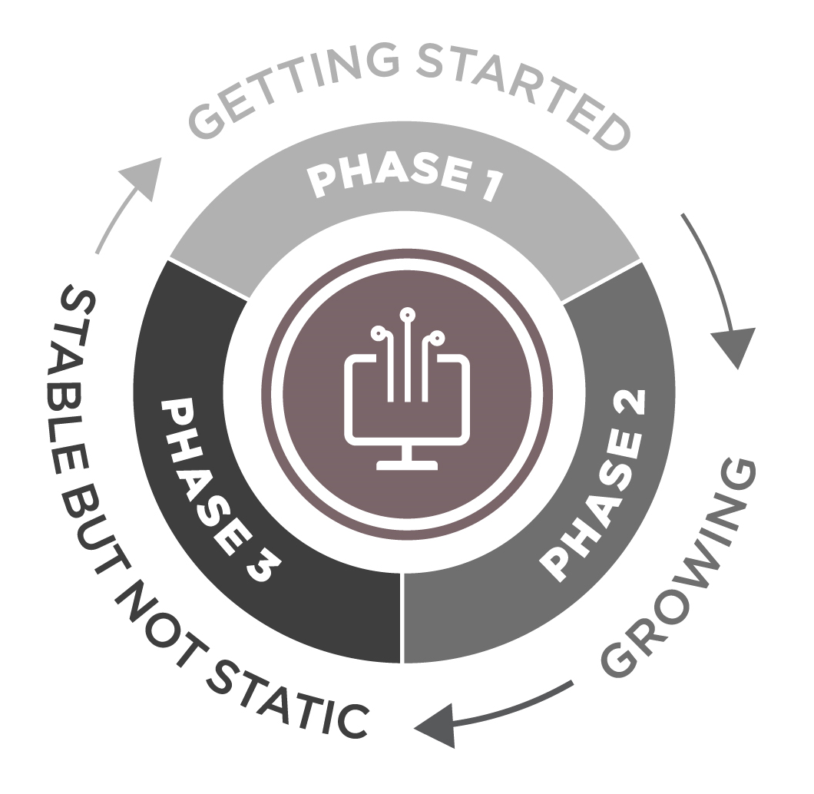
Facet: Technology – Core?
Characteristics
  Laying the groundwork: Design, pre- or early beta release
  Expanding and integrating: Have a formal release process and being used outside the founding orgs
  Preparing for change: Strong but looking forward to next generation
How do you evaluate?
Questions to ask?
Notes:
Technology may or may not be core to the program.
Phase I - in design, pre-release, or the early beta testing phase. They may have no implementations, or a small set. The core goal -turn an idea into a viable product that serves the needs of the community.
Phase II - more than one public release, formal release process, generally adding new features and functionality to the application. The core goal - refine application by amplifying things that are working well and phase out less successful.
Phase III - in production, well-adopted and supported. The technology stack stable, and programs may be looking to update to next generation technologies. The core goal - determine how the technology stack will serve the future needs, and plan ahead for expansion, integration, or re-architecture.
Evaluate:
Seed suggestions: Focus on core needs - small, solid releases. Grow thoughtfully –don’t be afraid to prune. Think about integration. Plan for evolution.
Questions:
Seed questions: Is there a tech roadmap? how often updated? Who’s making decisions about new functionality? Is all development done by the program? Infrastructure to support members contributing code? Are integrations being considered? Is there a long term plan for changes?

Slide 14
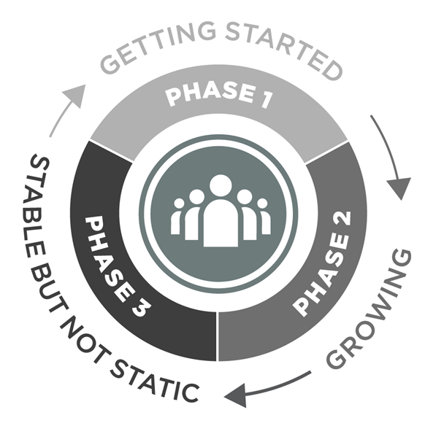
Facet: Resources – Human and Fiscal
Characteristics
  Creating consistency: Typically single owner or champion
  Diversification: Distributed resourcing
  Stable but not Static: Diverse support and income streams – focused on long range strategy
How do you evaluate?
Questions to ask?
Notes:
In order to launch, grow, and thrive, programs need resources both human and fiscal. Human resources encompass engineers writing code, community members providing use cases, or organ homes with fiscal stewardship. Financial resources come in and go out in a wide variety of ways – in via contributions, grants, dues, sponsorships, etc., and out via salaries, and overhead.
Phase I-usually funded by a single organization, grant-funded, or volunteer operated. The core goal -create a sustainability plan that will provide a consistent and sustained level of resources.
Phase II - more distributed resourcing, but have a small number of revenue streams. The core goal -diversify income streams and talent pools to mitigate reliance on 1 source of income or member.
Phase III - diverse staff support/income streams -more focused on long-range strategy. The core goal - resilience, ensuring that they can continue to evolve to meet the community’s needs.
Evaluate
Seed suggestions: Planning, planning, planning – sustainability doesn’t happen by magic. Understand options for obtaining sustainable resources, e.g. earned income, members, etc. Don’t underestimate human resources needed– community engagement, program management, tech leadership. Think about partners and collaborators – can be vendors, too.
Questions
Seed questions: Is there a strategy to get beyond grant funding. Are more than core stakeholders contributing? succession plan? Where they are housed – e.g. university, home org, etc. Is that a long-term solution?

Slide 15
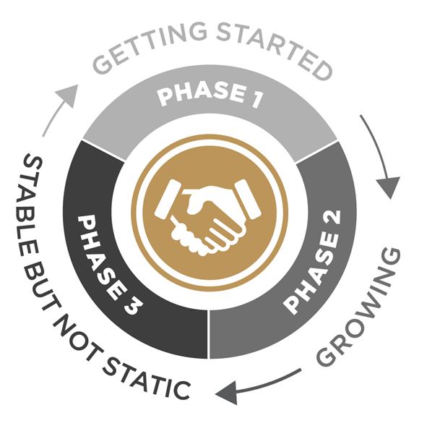
Facet: Community Engagement – Users → Stakeholders
Characteristics
  Getting beyond initial stakeholders: Lack of engagement with broader community
  Establishing infrastructure: Enable engagement
  Evolving: Well-established infrastructure – variety of opportunities
How do you evaluate?
Questions to ask?
Notes:
The CE facet reflects efforts to facilitate and foster involvement within a community. It is focused on encouraging users to become stakeholders. Those who have a sense of investment and ownership become champions who want the program to grow and succeed.
Phase I - focused on their primary stakeholders, and often have a lack of engagement with the broader community. The core goal - is to identify and involve a wider group of stakeholders.
Phase II - working to determine how to facilitate engagement that works best for their community. The core goal - to bring more community members into the folder, turning users into stakeholders.
Phase III - have an established infrastructure to enable engagement. The core goal - continue to evaluate and evolve the engagement model to keep up with new technologies, communities, and collaborators.
Evaluate
Seed suggestions: Are you working to engage the community? Is community engagement the responsibility of someone on the program team? Do you have a plan/strategy? Do you have a infrastructure?
Questions?
Seed questions: Is the program regularly communicating out? Is it easy to find information, updates, users, program team members? Do community members encouraged to contribute to communications – write blog posts, make presentations? Diversity of engaged participants or do they all “look” the same – e.g. all R1.

Slide 16
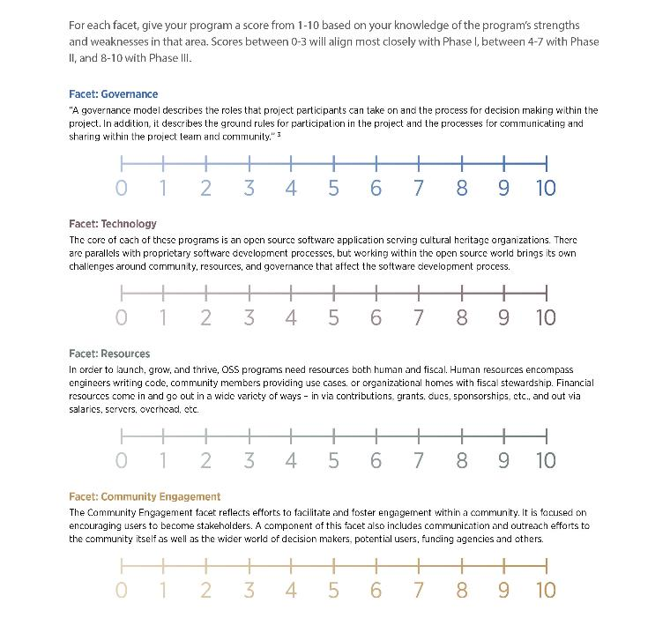
Notes:
To mention as tool to help

Slide 17
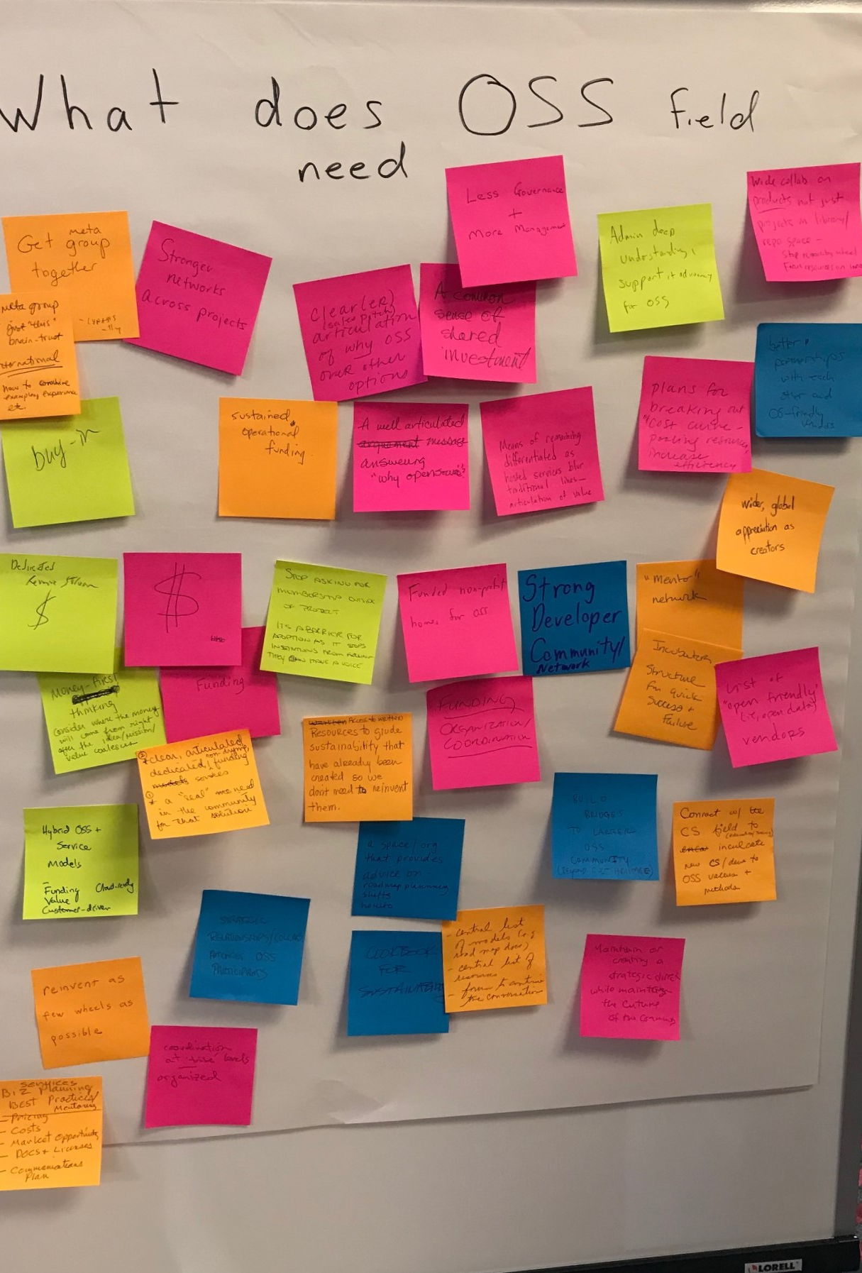
Next Steps
Useful for YOU?

Slide 18
please contact us for more info
Phone 800.999.8558
Email laurie.arp@lyrasis.org
wearelyrasis
lyrasis
By Laurie Gemmill Arp
LYRASIS, Director, Collections Services & Community Supported Software
Guidebook and project info at: www.lyrasis.org/itav

