Slide 1
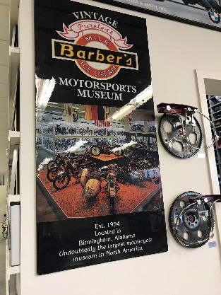
LYRASIS
Leaders Forum #6
Birmingham
by Robert Miller
CEO LYRASIS
Notes:
Host Lee Woehle (Vintage Museum), Loretta ACRL Librarian of the Year,
Leaders Circle call outs Dr. Franklin/Cedric Davis, Annie Payton, Dr. Alan Bearman, Nancy Couler
State Library – Nancy

Slide 2
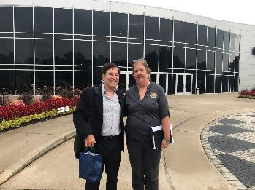
LYRASIS
Thank you’s!
Host - Lee Woehle (Barber Museum), Loretta Parham ACRL Librarian of the Year, Leaders Circle call outs Dr. Franklin/Cedric Davis, Annie Payton, Dr. Alan Bearman, Nancy Colyar , Daniel Zeigler and State Librarian – Nancy Pack
CEO LYRASIS
by Robert Miller
Notes:
Host Lee Woehle (Vintage Museum), Loretta ACRL Librarian of the Year,
Leaders Circle call outs Dr. Franklin/Cedric Davis, Annie Payton, Dr. Alan Bearman, Nancy Couler
State Library – Nancy

Slide 3
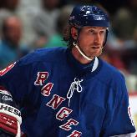
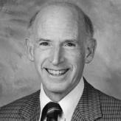

Why Think About the Future Now?
When asked how he scored so many goals, Wayne Gretzsky allegedly said,
I skate to where the puck is going to be,
not where it is.
Planning is bringing the future into the present so that you can do something about it now.
Alan Lakein
If we could first know where we are, and whither we are tending, we could better judge what to do, and how to do it.
Abraham Lincoln

Slide 4

Sustainable and Disruptive Innovation
Sustainable and Disruptive
Innovation

Slide 5
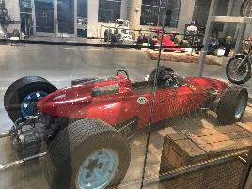
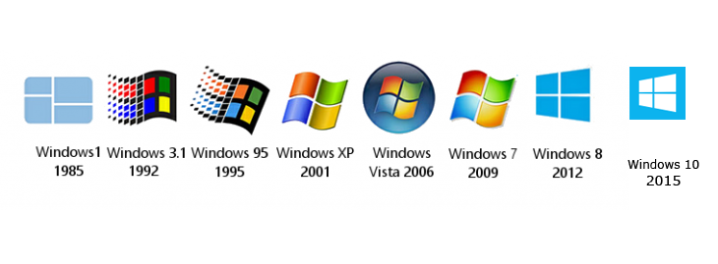
Sustainable Innovation
Sustaining innovation seeks to improve existing products. It does not create new markets or values, but rather extends/expands existing ones.
Example:
Notes:
Text from Deloitte.com

Slide 6

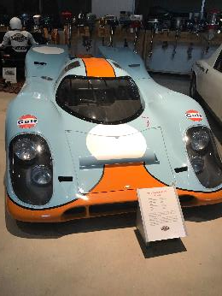


Disruptive Innovation
Disruptive innovation means to reinvent a technology, business model, or simply invent it all together. Disruptive innovation generates new markets and values, in order to disrupt existing ones.
Examples:
Notes:
Text from Deloitte.com

Slide 7


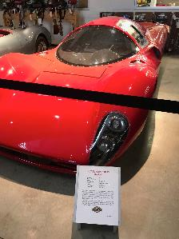
The Dilemma
The “innovator’s dilemma” is the tough choice any company faces when it has to choose between holding onto an existing market by doing the same, yet slightly better (sustaining innovation), or capturing new markets by embracing new technologies and adopting new business models (disruptive innovation).
Sustaining:
Disruptive:
Next Year’s Model
App Based Car Service
or
Notes:
Text from Deloitte.com
In order to achieve cutting-edge innovation within a company while creating a long-lasting business advantage, the latter should aspire to achieve both revolution and evolution. In other words, disruptive innovation andsustaining innovation do not necessarily need to be alternative to one another, but rather complementary measures.

Slide 8
LYRASIS’s Evolution of Membership
Membership
Thought leadership
Transactional
2016
2017
2009
Our roots go back to 1936

Slide 9

Making Sense of Our Environmental Trends
Technology
  Speed of change.
  Demands of users.
Services: Insource vs. outsource
  Make or buy decision.
  Measuring alternatives- quantitative methods and qualitative elements?
Staff: Specialized vs. generalist
  Depth of knowledge vs. broad skillset spectrum.
Partnerships: Leveraging connections
  For-profit, non-profit, government.
Measuring Value
  How to measure value of change!
  Where to invest?
  Test/Try
Short | Intermediate | Long-term

Slide 10


Positioning Our Members to Punch Above their Weight
Leaders Forums
Catalyst Fund
CEO’s Choice
Annual Summit

Slide 11
Working to Help Move the Mountain, Not Boil the Ocean
Archives
Gallery
Library
Museum
innovation across communities

Slide 12
Making Sense of Our Environmental Trends
Insource vs. outsource
  Make or buy decision.
  Measuring alternatives- quantitative methods and qualitative elements?
Specialized vs. generalist
  Depth of knowledge vs. broad skillset spectrum.
Leveraging partnerships
  For-profit, non-profit, government.
Value model
  How to measure value of change!
Short | Intermediate | Long-term

Slide 13


Leaders Circle
The LYRASIS Leaders Circle is a diverse group of knowledgeable professionals working together in a highly collaborative and results-focused environment to discuss challenges and design and foster real-world solutions within our community.

Slide 14
Leaders Forums
LYRASIS hosted 18 Leaders Forums, regional in-person meetings that…
pulled together a diverse cross section of thought leaders,
discussed, dissected and focused on cross-functional challenges
explored opportunities
set the stage for ideation, exploration and creation
Leaders Forums

Slide 15

Catalyst Fund
What? LYRASIS created the $100,000 Catalyst Fund to help us all punch above our weight and to fill in the funding gap identified by the Leaders Circle.
How? We devoted a portion of our organizational endowment as seed funding to test/try fantastic ideas into real world projects.
Output? White paper, sustainability plan, sandbox, etc.
Seed fund member ideas

Slide 16


Ideas…
In our inaugural year of the program, we anticipated receiving a handful of applications, maybe 10. Imagine our surprise when received 61!
Investing in our members

Slide 17






This year we are funding 5 Catalyst Seed Fund projects and 1 CEO’s choice idea

Slide 18

Idea: IUPUI University Library
LYRASIS Liaison: Hannah Rosen
Impact: Lower cost and increase acceptance - Sets the stage for the standardization of digital collections of 3D artifacts on a national scale. $29,500

Slide 19

Idea: University of Nebraska at Omaha
LYRASIS Liaison: Jennifer Bielewski
Take the solution to the location - Digitized collections and resources on developing the mobile lab will be shared with others for implementation. $5,550

Slide 20

Idea: Washburn University of Topeka Libraries
LYRASIS Liaison: Michael A. Dixon
Impact: Creates a replicable mobile app on a national scale with open access resources adaptable to any classroom curriculum. $26,548

Slide 21

Idea: Johnson C. Smith University, HBCU
LYRASIS Liaison: Annie Peterson and Michael A. Dixon
Impact: Johnson C Smith – Documents an historic community and will share resources on the creation of an interactive map and digital app. $25,000

Slide 22

Idea: The Trustees of Columbia University in the City of New York
LYRASIS Liaison: Tom Clareson and Alicia Johnson
Impact: Determines the viability and sustainability of a copyright education center for libraries, archives and museums. Rollout a DYI model to clear copyright at scale $30,000

Slide 23

Idea: University of North Carolina Charlotte
LYRASIS Liaison: John Herbert
Impact: Can “Hello Alexa or Hello Google” change how ‘we’ interact with content or knowledge…i.e. a visually impaired persons to interact with a library’s collections using voice interaction with an ILS. $17,000.

Slide 24

LYRASIS’s member summit
Leaders Circle day
  C$F presentations
  Fy 2018 Shark Tank
Membership Summit
  IMPACT and Innovation
  Deanna Marcum
  If you had $26 billion …
Break outs
  OSS summary
  4 Work shop – DIY Copyright, Tech, Software
  LF’s summary
  Meet with an expert
Notes:
And this is the fun part. When, not if, we do this, what might this create, allow us to ‘do’ or be recognized for…
Milestones –
20th petabyte of data contributed
1 billionth user
1,000 th training class
C$F development model is now taught in Library School – NYBERG model
Awards
UNESCO – preserved their 5th heritage site (1052 total, 35 mixed natural and cultural)
Atlas standard – integrated multi-content platform used in k-12, colleges and grad school
Tech and ideation committee – 5 years old, 2 acquisitions (one profit and one non-profit), 2 partnerships (one facebook and one with the Phoenix Foundation
Board Rotation – our focus has shifted from just libraries and not excluded publics, archives or museums – we now are deeply involved with other parts of campus, technology and science.
Dean of Eng – Cal Poly
Dean of MGT – MIT Sloan school of management
Dean of CS/AI from Ga Tech
MGR Director from hóng bāo, Beijing
Director from the Welcome Trust UK
Speakers – our need for knowledge and a broader engagement with our community is reflected by whom we work with, talk to and listen to.
Ministry of Education Singapore – East/West Learning strategies, Mr On Ye Kong, Parliamentary Secretary of Education
2021 Nobel price winner in Communication Theory and Learning Behaviors
And yes, our anti fragile planning has allowed us to weather the recession that struck for 32 months during the window from 2017-2027!

Slide 25
please contact us for more info.
Phone 415.640.1092
Email robert.miller@lyrasis.org
wearelyrasis
lyrasis
By Robert Miller
CEO LYRASIS

Slide 26
please contact us for more info.
Phone 415.640.1092
Email robert.miller@lyrasis.org
wearelyrasis
lyrasis
By Robert Miller
CEO LYRASIS

Slide 27
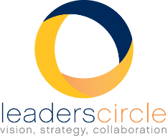
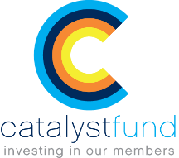
Leaders
Forums
3 Pronged Strategy
The Catalyst $100,000 Fund fits as part of our 3-pronged strategy (Leaders Forums, Leaders Circle, and Catalyst $100,00) Fund) to help improve the impact of your institution has on your and the LYRASIS community.

Slide 28

Answer…
Now is the best time to prepare so we know where we might end up!
As we continue to advance and uphold our mission today, it is equally important to keep our eye on tomorrow and the future.

Slide 29

The Offspring of the Catalyst Funding
Foundations Group funding
  The success of the C$F will expand and deepen our Grant Funding relationships
Services - program - hole in the roof
STDS
Fair pricing – sustainable

Slide 30
LYRASIS’s member summit
Leaders Circle day
  C$F presentations
  Fy 2018 Shark Tank
Membership Summit
  If you had $26 billion …
  And if you didn’t …
Break outs
  OSS summary
  Work shop – DYI Copyright
  LF’s summary
Notes:
And this is the fun part. When, not if, we do this, what might this create, allow us to ‘do’ or be recognized for…
Milestones –
20th petabyte of data contributed
1 billionth user
1,000 th training class
C$F development model is now taught in Library School – NYBERG model
Awards
UNESCO – preserved their 5th heritage site (1052 total, 35 mixed natural and cultural)
Atlas standard – integrated multi-content platform used in k-12, colleges and grad school
Tech and ideation committee – 5 years old, 2 acquisitions (one profit and one non-profit), 2 partnerships (one facebook and one with the Phoenix Foundation
Board Rotation – our focus has shifted from just libraries and not excluded publics, archives or museums – we now are deeply involved with other parts of campus, technology and science.
Dean of Eng – Cal Poly
Dean of MGT – MIT Sloan school of management
Dean of CS/AI from Ga Tech
MGR Director from hóng bāo, Beijing
Director from the Welcome Trust UK
Speakers – our need for knowledge and a broader engagement with our community is reflected by whom we work with, talk to and listen to.
Ministry of Education Singapore – East/West Learning strategies, Mr On Ye Kong, Parliamentary Secretary of Education
2021 Nobel price winner in Communication Theory and Learning Behaviors
And yes, our anti fragile planning has allowed us to weather the recession that struck for 32 months during the window from 2017-2027!

Slide 31
Leaders
Forums
Leaders Circle > Leaders Forums > Catalyst Fund
>
>

Slide 32

What is the Catalyst Fund?
$100,000 to fund new ideas!
The LYRASIS Catalyst Fund is a $100,000 award program to seed fund new ideas and projects by LYRASIS members. The Catalyst Fund is a new membership benefit and is administered by the LYRASIS Leaders Circle. It was designed as a direct result of member requests for expertise, collaboration and perspective, and all projects resulting from the Catalyst Fund will be shared at our annual Member Summit.

Slide 33
Why?
The Catalyst $100,000 Fund is part of a dramatic shift that is going on at LYRASIS. We are building on our core competence of transactional skills and services (eContent, Digital Services and Software solutions) and have launched, for our members, a thought leadership level that many of our members now need.

Slide 34
From Information Literate to Information Fluent
Dr. Alan Bearman

Slide 35
Mabee Library
Book Repository to a Center for Student Success
Physical Renovation
Shelving Removed
Utilization of Off-Site Storage and Compact Shelving
Coffee Shop
Multi-Use Zonal Spacing and Furniture
Role of Librarians and Staff
Payroll Allocation
Custodians of Knowledge to Instructors of Information Literacy

Slide 36
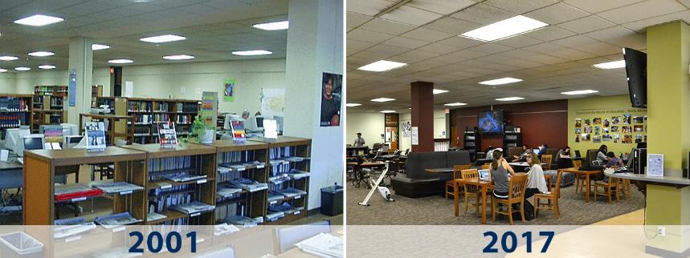
Mabee Library

Slide 38
From Information Literate to Information Fluent
University Student Learning Outcomes Revision, 2013
The previous 9 USLOs became 4, with a new 5th USLO
Communication
Quantitative and Scientific Reasoning
Information Literacy and Technology
Critical and Creative Thinking
Global Citizenship, Ethics, and Diversity

Slide 39
From Information Literate to Information Fluent
Credibility becomes more important than owning “Stuff”
University Libraries claimed responsibility of building a First-Year Experience Program around the USLO of Information Literacy and Technology
Wanted to immediately create for students a conversation regarding: The Credibility of Information in the Knowledge Economy
WU101: The Washburn Experience now drives First-Year student success

Slide 41
From Information Literate to Information Fluent
Lyrasis Catalyst Fund
Students coming to Washburn University with limited understanding of Information Literacy
Students coming to Washburn University picturing the Library as a book filled “scary” place

Slide 42
From Information Literate to Information Fluent
Lyrasis Catalyst Fund
Seeking to create Open Source Information Literacy modules for area middle and high schools
Seeking to assist students in developing Information Literacy skills that translate seamlessly from high school to college
Seeking to create independent, successful life-long learners who are Information Fluent for the Knowledge economy

Slide 43
From Information Literate to Information Fluent
Lyrasis Catalyst Fund
20 area middle/high school librarian partners
Average ratio of librarians to middle school students of 486:1
Average ratio of librarians to high school students of 1,344:1

Slide 44
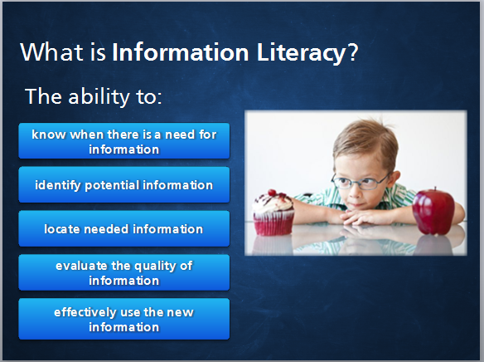

Slide 45
From Information Literate to Information Fluent
(Immediate) Lessons Learned
Middle & High School Librarians see this project as one that can illuminate their value as something other than Tech Support
Bi-Lingual
Partnerships

Slide 47
Emergence of
Open Content
September 14, 2017
Jill Grogg
Licensing Program Strategist
[ih-mur-juh ns] Formation of collective behaviors causing a system to coalesce into something novel
Notes:
Open Content movement is emerging in the true sense of the word.

Slide 48


Signs of Change
Paywalled
Open
Industry consolidation
Private equity
Mature market
Barriers to competition
Potential for disruptive change
Multi-stakeholder collaboratives
Social responsibility
Opportunities to engage
Community energy
Notes:
Emphasis in conversation is shifting away from commercial content and towards open content
In commercial paywalled content sector we see:
Mergers and acquisitions – that are a sign of a mature market, especially when private equity gets involved
New services from publishers (as opposed to new content products) aimed elsewhere on campus, not the libraries as the usual acquirers of content
Why are these trends happening? It’s a mature market without a high growth potential. Libraries as funding sources are tapped out.
Also – why are funders straying from their lane? Why has the Gates Foundation invested both in ResearchGate (scholarly sharing network where researchers post copies of their articles for use by others) and in a new open research hosting platform with the Faculty of 1000 life sciences publisher (known as F1000)? Because they see a potential to disrupt the established scholarly communication ecosystem.

Slide 49
Relationships
Open Content
Open Education
Open Educational Resources
Open
Access Scholarly Publishing

Slide 50





Trending Now
Openly licensed cultural content
    (copyrightable materials of all formats that may be freely and legally reproduced, edited, expanded, and republished)
      Digital learning objects
      Primary source documents
      Local/regional content
      Scholarly content
      Technical content
Social responsibility and long-term obligations
Knowledge diffusion network
SCOAP³
Notes:
Trending now:
Openly licensed cultural content
Copyrightable material, such as documents, images and audio or video presentations that may be freely and legally reproduced, edited, excerpted, expanded and republished. Often via one of the Creative Commons licenses.
Museums on campus with learning objects to digitize
Archival/primary source content
Local regional content
Scholarly content
Need to think beyond the financial bottom line and begin to take into account our social obligations to long-term user needs, balancing with the mission of the LAM to participate in the knowledge diffusion network (MIT – social responsibility policy)
GLAMS need to think of themselves as part of the greater knowledge diffusion network.

Slide 51




Taking Action
“Not self-indulgence, but self-preservation”
Support for progress of intellectual thought and expression in a sustainable manner
Multi-stakeholder alliances
Digitization to Digitality
Investigate, collaborate, promote, and accelerate adoption of Open using a holistic approach
Instigate change
Notes:
Action Items - “Not self-indulgence, but self-preservation”
Support the progress of intellectual thought and expression in a sustainable manner
Engage in multi-stakeholder alliances – such as Lib Publishing Forum, OSI (UNESCO), Open Knowledge International. Library publishing is a new way to engage, future-proof, provide archival home, help libraries gain support on campus and be anti-fragile. Using combined expertise of university presses and LAMS in a region to provide sustainable ecosystem for open content.
Move from digitization to digitality (the condition of living in a digital culture; digital reality)
Hope for LYRASIS – be more of an instigator of change in the open content space, along with our work to facilitate change. LYR can help OA scale up by creating synergy across OA projects, growing work with dig vendors – ~100 distinct projects this fiscal year, added educational outreach about new models to support open content

Slide 52
Questions
How do you envision that your organization will be engaging in the Open Content movement in the next 5 years?
What are the driving forces behind the Open Content momentum in your environment?
What are the barriers in your organization that slow down or prevent the transition to more to Open Content?

Slide 53
please contact us for more info.
Phone 800.999.8558
Email jill.grogg@lyrasis.org
wearelyrasis
lyrasis
Jill Grogg
Licensing Program Strategist

Slide 54
Software / Technology
Costs and Decisions
John Herbert
Director – Technology Services

Slide 55

Observations
Movements within the landscape
  Open-Source
  Software as a Service (SaaS)

Slide 56

Open-Source Software
Benefits
Community and Collaboration
Sharing resources
Getting what you need
But …..
Often developed in stand-alone fashion
Driven by large institutions / technologists
Many projects, platforms
Confusing landscape
Sustainability is a challenge

Slide 57

Software as a Service
Institutions everywhere dis-engaging from operating all the software they need
  Prominent, world renown universities are outsourcing
  Smaller, community-based org’s don’t have dedicated IT resources
Relinquishing control of smaller, less enterprise-critical platforms
Allowing 3rd party service providers to handle infrastructure, technical support

Slide 58

Decisions, Decisions, Decisions
Cost-Benefit Analysis
  Total cost vs. Total benefits
Many pieces to the puzzle
  Commercial – license; gen’l use case
  Open-source – not free; longer timeline
  Hardware – infrastructure and security
  Software – local vs. cloud
  Staffing – setup and ongoing support
    Both IT and user areas
  Workflow development / modifications
  Data migrations
  Integrations w/ other platforms
  Scale-ability

Slide 59
Questions
How do you/your institution view technology decisions?
How strategic / long-term is your horizon?
How closely do you examine total costs?
What criteria do you consider?
  Is open-source among them?
  Cloud hosting?
Would a more structured total-cost model be useful?

Slide 60
Three Generations: Case Study by David Lewis, IUPUI

Slide 61
Three Generations in the Library: A Case Study
For some time, you have been thinking about the librarians in your library and have been concerned with several issues.
You are worried about succession planning. You expect to retire in two years at age 68. In the past, you were not overly concerned, but you have noticed that many libraries like yours are having trouble finding good candidates for director’s positions. All of your associate directors and department heads, except for one, are baby boomers and will retire in the next five or six years. You are not sure any of them are ready to be director or that any of them are interested in the job. The mid-career librarians mostly don’t seem interested in leadership. You have recently become concerned that the library will not have anyone to step into leadership roles after the current leadership team retires.

Slide 62
Three Generations in the Library: A Case Study
While you have generally been able to recruit good beginning level librarians, over that past few years the candidate pools have gotten smaller and you have had to offer larger start salaries.
The higher starting salaries for new librarians has caused salary compression. Some of the mid-career librarians have begun to grumble.
In the past two years three of your beginning librarians have left for more interesting position or higher salaries. In exit interviews, several said that working in your library was fine, but their new position offered more interesting opportunities. Another left when a spouse relocated.
You have been unable to increase the diversity of the librarians in your library even though diversity is a campus priority.

Slide 63
Three Generations in the Library: A Case Study
Library Demographic Summary
Last name | Date of Birth | Age | Start Date | Tenured | Rank | Women | Minority | Salary
Howard | 03/28/47 | 70.7 | 07/01/00 | 1 | Associate | 1 | 0 | $72,500
Shively | 09/14/51 | 66.2 | 08/16/93 | 1 | Librarian | 0 | 0 | $135,000
Johnson | 10/01/51 | 66.2 | 09/18/89 | 1 | Associate | 0 | 0 | $85,000
O'Bannon | 09/21/53 | 64.2 | 06/01/02 | 1 | Associate | 1 | 0 | $87,000
Sanchez | 10/21/54 | 63.1 | 07/08/02 | 1 | Associate | 0 | 1 | $85,500
Javan | 09/12/55 | 62.2 | 07/01/94 | 1 | Associate | 1 | 0 | $62,500
Wilkinson | 07/15/57 | 60.4 | 01/15/97 | 1 | Associate | 0 | 0 | $68,500
Smith | 10/21/59 | 58.1 | 07/01/02 | 1 | Librarian | 1 | 0 | $82,000
Williams | 06/25/60 | 57.4 | 10/26/90 | 1 | Associate | 0 | 0 | $73,500
Brown | 08/24/61 | 56.3 | 06/25/01 | 1 | Associate | 0 | 0 | $59,500
Kline | 03/04/64 | 53.7 | 03/02/03 | 1 | Associate | 1 | 0 | $62,000
Jackson | 08/05/67 | 50.3 | 01/15/10 | 0 | Assistant | 1 | 0 | $57,500
Miller | 06/26/75 | 42.4 | 06/02/03 | 1 | Associate | 1 | 0 | $62,000
Turner | 07/27/78 | 39.3 | 07/01/07 | 1 | Associate | 1 | 0 | $56,000
Lloyd | 09/02/78 | 39.2 | 10/01/11 | 0 | Assistant | 1 | 0 | $55,000
Wheeler | 11/15/79 | 38.0 | 01/13/08 | 0 | Assistant | 0 | 0 | $54,000
Kent | 11/25/79 | 38.0 | 08/01/14 | 0 | Assistant | 1 | 0 | $53,000
McFall | 02/10/84 | 33.8 | 08/01/14 | 0 | Assistant | 1 | 1 | $53,000
Lee | 12/02/85 | 32.0 | 01/06/15 | 0 | Assistant | 1 | 1 | $52,500
Happel | 12/01/88 | 29.0 | 07/05/10 | 0 | Assistant | 0 | 0 | $54,000
Hartman | 06/15/89 | 28.5 | 10/13/16 | 0 | Assistant | 1 | 0 | $50,000
 | Total |  |  | 13 |  | 13 | 3
 | Average | 50.0 |  | 61.9% |  | 61.9% | 14.3%

Slide 64
Three Generations in the Library: A Case Study

Slide 65
Three Generations in the Library: A Case Study
Director - Shively
AD Services – O’Bannon
AD Collections - Johnson
AD Digital Stuff - Smith
Access Head - Brown
Instruction - Kline
Acquisitions Head - Lloyd
Systems Head - Javan
Catalog Head - Williams
Repository Libr- Miller
Liaison Libr - Turner
Liaison Libr - Sanchez
Catalog Libr - Wheeler
User Exper- Happel
Liaison Libr - Lee
Liaison Libr - Kent
Metadata - McFall
Liaison Libr - Jackson
Liaison Libr - Hartman
Special Coll Head - Howard
Archivist –Wilkinson

Slide 66
Three Generations in the Library: A Case Study
In researching the situation, you come across Stanley Wilder’s recent ARL report “Delayed Retirements and the Youth Movement among ARL Library Professionals.” You have been worried about the different generations of librarians and how this will impact the profession as a whole and particularly your library. You convert Wilder’s data to reflect the different generations and do some quick calculations on the data to project it out a few years. The result is the chart and graph below.
It looks like many academic libraries are in a situation similar to yours. You are particularly concerned with the coming need to attract a large number of younger librarians in the next five to seven years.
Finally, you were review statistics on diversity in academic librarianship and found the last chart below. You wonder what you and your library can do to change this situation.
Stanley Wilder, “Delayed Retirements and the Youth Movement among ARL Library Professionals,” Washington, DC: Association of Research Libraries, 2017, http://www.arl.org/storage/documents/publications/rli-2017-stanley-wilder-article1.pdf

Slide 67
Three Generations in the Library: A Case Study
 | 1986 | 1994 | 2005 | 2015 | 2025
Millennium 1981-2000 | 0.0% | 0.0% | 0.2% | 13.5% | 45.0%
Gen X 1965-1980 | 0.0% | 3.0% | 23.4% | 39.1% | 40.0%
Baby Boom 1946-1964 | 38.2% | 62.0% | 62.7% | 47.3% | 15.0%
Silent 1927-1945 | 52.4% | 32.3% | 13.7% | 0.0% | 0.0%
G.I. Generation pre-1927 | 9.4% | 2.7% | 0.0% | 0.0% | 0.0%

Slide 68
Three Generations in the Library: A Case Study

Slide 69
Three Generations in the Library: A Case Study

Slide 70
Three Generations in the Library: A Case Study
What do you do?

