Slide 1
LYRASIS Leadership Forum
Columbus
Robert Miller, Celeste Feather, Laurie Arp, John Herbert, Mary Meyer, Meg Blum and Jennifer Bielewski

Slide 2
Licensing and Strategic Partnerships
Celeste Feather
Senior Director of Licensing and Strategic Partnerships

Slide 3
Material People Contribute to the Online World
Structured
Licensed content
Scholarly Open Access content
TEDx
Wikimedia
Kudos
Traditional
Non-traditional
YouTube
Digital humanities
Open data
Local/archival
collections and
repositories
Unstructured
Notes:
Share a visualization or framework of how we’re thinking about the world of digital content, defined simply as “material people contribute to the online world.”
Multiple ways for educational and cultural heritage organizations to bring this content to their communities: buy it, collaborate to fund it, and create it locally.
Viewing the current scenario through a four-quadrant matrix of traditional, non-traditional, structured, and unstructured content. Clearly there are other lenses through which we can view this realm, such as custody vs. access, text vs. other formats, content with stakeholders vs. content without, discoverable vs. not, etc.
In upper left, traditional content modified for the online environment, mostly structured in familiar ways. Licensed content – mostly behind paywalls. Open Access content in the scholarly realm that is still structured along traditional publishing lines. However, there is significant churn around appropriate business models to bring this content online, in terms of funding mechanisms, usage rights, and overall usability. Although more traditional, this quadrant is far from calm, settled, and mature.
In lower left, local, unique collections are coming online from in many cases unstructured environments, and here we see now a lot of activity around creating these collections from primary sources, curating them, and putting some structure around them in order to gain advantages for discoverability and research.
In the upper right, we have new formats of materials that have come online within a structured environment and collection such as the TEDx local speaker videos and the Wikimedia educational media files. Kudos – which gives authors the opportunity to describe their research in terms that a lay person can understand, and then connects that description with social media, is another example of a new kind of content that is being amassed within a structured environment.
Finally, in the lower right, we have non-traditional material without much formal structure to date. Here I list as examples YouTube, the swirl around digital humanities projects and scholarly output, and open research data.
We here at LYRASIS are now deeply engaged all across the left side of the matrix, and it’s exciting to think about possibilities for non-traditional material.

Slide 4




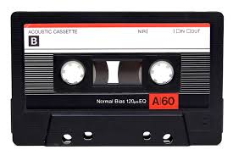
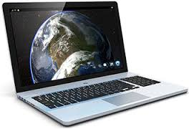


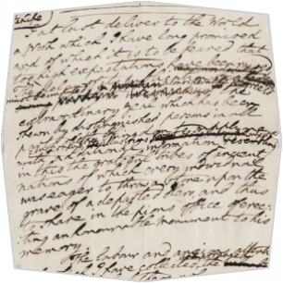
Evolution of Online Content, Containers, and Context
Notes:
Another way to think about the complexities we face today is by examining how we got to where we are.
Familiar containers of content flowed into the digital realm, at first in much the same way that they were contained in their physical format. But over time:
Print multi-volume reference works became databases
Journal articles didn’t need to be in volumes and issues any more
Ebooks were envisioned as being much more than just flat text (note digital humanities movement of today)
Some content became free to use
Datasets were posted
Exciting curated digital collections of multiple formats – text plus images, audio and video, enhanced the user experience
And now what?
Our values haven’t changed. We are still:
Providing and enhancing access to content that might help users change the world
Working together to create a greater good
Collecting, curating, and preserving
Now that primary source documents and scholarly content is served up in a manner similar to mass market information, we need to re-architect the scholarly communications system along the same principles as we use for mass communication:
Is the message expressed clearly?
Do people understand the message?
Are people engaging with the ideas?
And are there impacts on society from the availability of this content?
We are working hard on a sustainable ecosystem, using web technologies, that take advantage of the opportunities to provide more suitable containers for each type of content. Information thrives in context, and now we have many more opportunities to share information within the context that enriches it.
For example, take the ebook marketplace that is under such hot debate. The problem really is about finding a sustainable model to present the content in the most appropriate way. Even though print is still a suitable container for some kinds of content, for certain purposes, if we continue to make business model decisions based in the print era, we’ll inhibit the adoption of more expansive and accessible modes of communication.
The challenges in the licensed content arena we’re confronting now are traumatic only when we don’t view them as opportunities. We need to get past the trauma of disruptive change and seize the opportunities the web provides.

Slide 5
Questions
How is your local environment transitioning to fund local publishing and content that is openly accessible, through digitization, born digital projects, and collaborative funding efforts?
How do you measure the impact of this work?
What linkages do we need to create in order to increase the impact of content on society?
What else can our community do to provide context for this locally created/digitized knowledge so it can thrive?
Notes:
How is your local ecosystem transitioning to fund local publishing, and content that is openly accessible, through digitization, born digital projects, and collaborative funding efforts? We know that the funding directed to this transformation still pales in comparison to what is still spent in the more mature digital content products through traditional licensing (even though it seems a lot premature to call that “traditional” given the churn of business models and usage rights in the marketplace today!)
How do we measure the impact of our new work? What kind of usage data, altmetrics, etc. is needed?
What linkages do we need to build and support to increase the impact of content on society? “Tools” like Kudos and ORCID are really just functional underpinnings that are helping to evolve the whole ecosystem.
What else must our community do to provide a context for this knowledge so it can thrive?

Slide 6
LYRASIS + DuraSpace
Empowering Communities with Open Technologies, Content Services and Digital Solutions
Robert Miller, CEO LYRASIS
Debra Hanken Kurtz, CEO DuraSpace

Slide 7
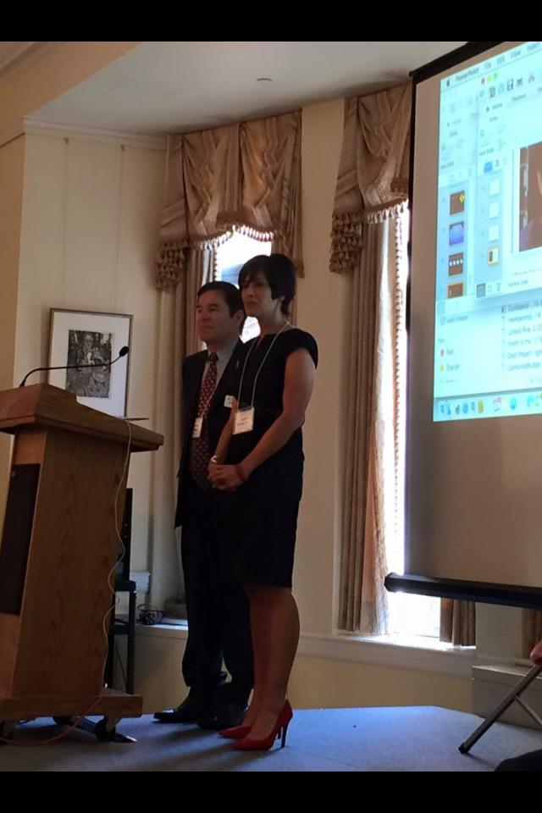
Draft joint mission statement:
LYRASIS/DuraSpace supports enduring access to our shared academic, scientific and cultural heritage through leadership in open technologies, content services, digital solutions and innovative collaboration with public and private knowledge communities worldwide.

Slide 8
LYRASIS – Parent Organization
DuraSpace – Software/Services Division
LYRASIS
Programs
Consulting
Digitization
Training &
Professional
Development
eResource Sales
Community
Source
Software
ASpace
CSpace
Dspace
Fedora
VIVO
Hydra
Hosted
Services
Islandora
Aspace
Cspace
DSpaceDirect
ArchivesDirect
DuraCloud
DuraSpace Ecosystem
Programs
Digital Preservation
Network (DPN)
SHared Access Research
Ecosystem (SHARE)
Hydra in a Box (HyBox)

Slide 9

Your Needs
MORE opportunities
to advance community interests and meet your needs
ENGAGEMENT A vibrant, global community of 6,000+ members, users, developers and consumers
ACCESS to 6 community source (and supported) technologies focused on access to and preservation of digital scientific and scholarly records
CONTENT 1,000s of institutions will increase eresources purchasing power
HOSTED SERVICES for any size institution with sales, training and customer services

Slide 10
End-to-End Asset Management Services
Plan
Consulting
Describe
ASpace
Manage/Access
DSpace
Preserve
Training
CSpace
DSpace
VIVO
Hydra/Fedora
Islandora
ArchivesDirect
Fedora
DuraCloud
Digitization
A merged organization brings together a broader participant base for community source projects which will promote greater adoption and provide a larger pool of technical expertise to grow the projects.
The combined services provide a diverse suite of tools for each step in the digital asset management process paired with professional expertise and consulting at every step.
Together, the organizations can pool expertise and participate in ecosystem activities to lead national preservation, curation, and data management efforts for benefit of their members and the broader academic community.

Slide 11
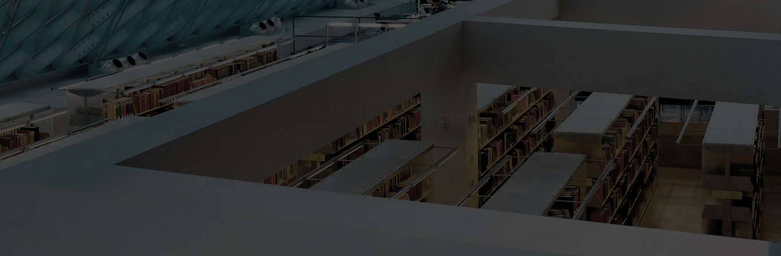
Their Needs
MORE opportunities
to advance community interests and meet their needs
ENGAGEMENT 6,000+ active community of members, users, developers and consumers from all over the world
ACCESS to 6 community source technologies focused on support for access to and preservation of the digital scientific and scholarly record
CONTENT 1,000s of institutions will increase eresources purchasing power
HOSTED SERVICES for any size institution with sales, training and customer services

Slide 12
please contact us for more info.
Phone 415.640.1092
Email robert.miller@lyrasis.org
wearelyrasis
lyrasis
Robert Miller, CEO LYRASIS
Debra Hanken Kurtz, CEO DuraSpace

Slide 13
Open Source Community Supported Software
Trends, pros/cons, example
Laurie Gemmill Arp
Director of Collections Services & Community Supported Software

Slide 14
Open Source Software Trends
Continued adoption and growth in academic and government settings
Improved technical infrastructure for distributed development
  Few to many
  github, SLAC, Jira
  DSpace: 84/26
Agile development process
  Methodology, flexibility, CSS model, all?
Continued evolution of sustainability models
  1 to community: shared governance, admin, membership
  Services: doc, training, hosting and support

Slide 15
CSS Matrix
Open Source
Pros | Cons
For & by community; designed to meet needs
“Ownership” – Voice in the operation and future | Potential learning curve
Continues to grow to meet community’s needs | Potential for orphan software
Collaboration | Collaboration – “far or fast”
“Free” | “Free” like kittens
Control | Documentation/Support/Training vary
Proprietary
Pros | Cons
Stability | Cost
Support | No voice
Usability | Frequently designed for other industry

Slide 16
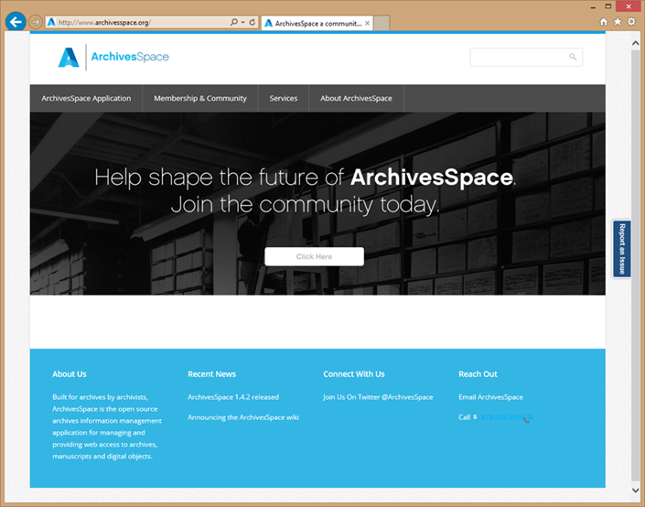
Current Example: ArchivesSpace
ArchivesSpace
  Open source archives information management application
  Background 2009-13
  Governance
  Membership model
  Organizational home
Focus/Challenge
  Functionality
  Expectations
  Transitioning from software consumers to software
  community of supporters/users

Slide 17
Questions
Are you using OSS?
What are the costs/benefits of open source vs proprietary for you?
  Internal, external fte cost, annual service fees, training and support
  Lost opportunity costs
What has been successful, and what has been challenging?
What projects/platforms are you evaluating now?
Who makes decision to migrate/How?
What services and support could LYRASIS put in place to remove barriers and/or improve success?
Notes:
Robert leads

