Slide 1
LYRASIS Leadership Forum 2016
Welcome wifi MoMIEducation, MuseumEducation
Your hosts: Robert Miller, Jay Schafer, Michele Kimpton, John Herbert, Celeste Feather, Laurie Arp, Debra Hanken Kurtz and Jenn Bielewski

Slide 2
eResources & Licensing
Celeste Feather
Senior Director of Licensing and Strategic Partnerships
Notes:
Former CEO of DuraSpace and prior DSpace Foundationand Internet Archive. Have spent last 10 years working to develop/promote and sustain community developed open source softtare. Over the last 10-15 years I have noticed increasing number of projects and larger adoptoin particuarly in library and government- both in the US and internationally. Today I would like to kick off an engaging discussion regarding CCS to hear from you your experiences, your concerns and your opportuntitie. Lyrasis brought me on board to help develop their strategy for continuing to support and expand the communty source software programs they are the home for. Different size institutions have different challenges in adopting OSS, and Lyrasis has been working on how to remove those barriers to adoption- what needs to happen to help sustain the software and improve adoption.

Slide 3
LYRASIS Licensing and Strategic Partnerships
Staffed by a team of 4 librarians
Rooted in work of legacy networks
Includes collaborative programs at national level

Slide 4
Material People Contribute to the Online World
Structured
Licensed content
Scholarly Open Access content
TEDx
Wikimedia
Kudos
Traditional
Non-traditional
YouTube
Digital humanities
Open data
Local/archival
collections and
repositories
Unstructured

Slide 5
Questions
Do you see the emphasis changing from content acquisition to content creation within your organization? Given stagnant budgets, what activities are no longer being performed so that efforts may be directed elsewhere?
What level of priority does your organization give to the creation and support of openly accessible content? And for what types of content and for whom?
What role should or does your library play in bringing together multiple departments to review new services that impact the entire organization? What role should LYRASIS play in expanding awareness of these services, and how can we assist members in this area?
What new models for hosting and accessing commercial content are being explored within your organization? What is the leading motivator, a desire for control or dissatisfaction with what commercial providers have developed so far?

Slide 6
Technology
Four Topics on a Broad Spectrum
John Herbert
Director of Technology Services
Notes:
Former CEO of DuraSpace and prior DSpace Foundationand Internet Archive. Have spent last 10 years working to develop/promote and sustain community developed open source softtare. Over the last 10-15 years I have noticed increasing number of projects and larger adoptoin particuarly in library and government- both in the US and internationally. Today I would like to kick off an engaging discussion regarding CCS to hear from you your experiences, your concerns and your opportuntitie. Lyrasis brought me on board to help develop their strategy for continuing to support and expand the communty source software programs they are the home for. Different size institutions have different challenges in adopting OSS, and Lyrasis has been working on how to remove those barriers to adoption- what needs to happen to help sustain the software and improve adoption.

Slide 7
Technology – Software
Trends
  Institutions everywhere dis-engaging from operating all the software they need
    Prominent, world renown universities are outsourcing
  Looking for more SaaS (Software as a Service) options of all kinds
    Allow a 3rd party to handle infrastructure, technical support

Slide 8

Technology – Software
Questions:
  What new directions do you see in the long arc of software evolution?
  What software needs do you have that aren’t being met?
  How does your institution determine the make vs. buy/own vs. lease?
  How do we move away from application-specific solutions to full end-to-end software services?

Slide 9
Discovery: Aggregating Digital Content
Trends
  Aggregator: single search portal that harvests content from many institutions
    Provides much larger exposure while maintaining local identity
  State, regional, national level
    Digital Library of Georgia, Texas Digital Library, Mountain West Digital Library
  DPLA – doing well, but might not have all the answers
    Digital Public Library of America
  Hydra-In-A-Box designed to standardize metadata for aggregation
    Great concept, but a couple years away

Slide 10

Discovery: Aggregating Digital Content
Questions:
  How do you insure your content is discoverable in all the places you would like to have it?
  How would you assess the state of aggregation services that are available to you today?
  What services are needed to make more progress?

Slide 11
Dissemination: Open- / Self-Publishing
Trends
  The lines are blurring ……
  Growing demand for “publishing” user-created content
  Academic/Commercial presses publish (relatively) narrowly
  Authors looking for non-traditional content and access
    Images, audio/video, data, indexing options, web 2.0 interactivity

Slide 12

Dissemination: Open- / Self-Publishing
Questions:
  How do we define “publishing” today?
  Is your institution providing any level of publishing assistance to your patrons?
  How do we develop “non-traditional” publishing forms so they can seen as viable?

Slide 13
Access and Preservation: Big Data
Trends
  Academia: granting agencies requiring it
    At least for a few years
  Researchers tend to deposit within their discipline
    Not necessarily within their institution
  Wide variety of content, software, file formats
    Long-term access and viability can be complex
  Normalizing disparate data sets can develop a knowledge base

Slide 14
Access and Preservation: Big Data
Questions:
  How much is your institution engaged? Are you making this a priority?
  How do you balance the discipline-specific repository with the need for long-term preservation?
  What standards, services are needed to advance this initiative?

Slide 15
Open source community based software
Michele Kimpton
LYRASIS expert
Notes:
Former CEO of DuraSpace and prior DSpace Foundationand Internet Archive. Have spent last 10 years working to develop/promote and sustain community developed open source softtare. Over the last 10-15 years I have noticed increasing number of projects and larger adoptoin particuarly in library and government- both in the US and internationally. Today I would like to kick off an engaging discussion regarding CCS to hear from you your experiences, your concerns and your opportuntitie. Lyrasis brought me on board to help develop their strategy for continuing to support and expand the communty source software programs they are the home for. Different size institutions have different challenges in adopting OSS, and Lyrasis has been working on how to remove those barriers to adoption- what needs to happen to help sustain the software and improve adoption.

Slide 16
Open source software trends
Continued adoption and growth in Academic and government
Improved technical infrastructure for distributed development (github,SLAC,Jira)
Open API’s to extend interoperability and functionality
agile development process
Continued evolution of sustainability models
  Shared governance and administration
  Financial sponsorship/membership
  Establishment of Organizational home as administer (not for profit)
  For profit home for support and services
Emerging vendor ecosystem
  Membership
  Service Providers
  For profit and not for profit companies

Slide 17
Digital lifecycle management
Notes:
With this larger portfolio, the new organization can begin to think about how to bring these open source projects and services together so users/orgs can be fully supported at any step in the management of their digital content.

Slide 18
Questions
Are you using OSS?
What has been successful, and what has been challenging?
What are the barriers?
What services and support could Lyrasis put in place to remove barriers and/or improve success?
What projects/platforms are you evaluating now?
Does this diagram resonate in any way?

Slide 19
Challenges
Sustainability (community, financial, administrative, technical)
Support
Effort to collaborate
Resources required for adoption

Slide 20
Examples

Slide 21
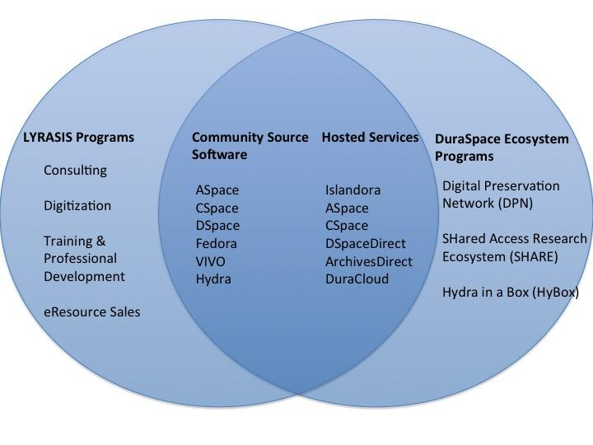
Operational overlap
Notes:
Over the past years Lyrasis has made a strategic decision to support OSS, and currently is the organizational home for Collectionspace and archivesspace. As part of that strategy, LYRAsis would like to build a set of services that better enable institutions to use OSS and participate in OSS projects.
With the current “intent to merge” with DS, if successful, the new organization will be the org home for initially 6 open source projects and a number of complimentary services.

Slide 22
Thank you!
Notes:
Former CEO of DuraSpace and prior DSpace Foundationand Internet Archive. Have spent last 10 years working to develop/promote and sustain community developed open source softtare. Over the last 10-15 years I have noticed increasing number of projects and larger adoptoin particuarly in library and government- both in the US and internationally. Today I would like to kick off an engaging discussion regarding CCS to hear from you your experiences, your concerns and your opportuntitie. Lyrasis brought me on board to help develop their strategy for continuing to support and expand the communty source software programs they are the home for. Different size institutions have different challenges in adopting OSS, and Lyrasis has been working on how to remove those barriers to adoption- what needs to happen to help sustain the software and improve adoption.

Slide 23
15 Minute Break
Notes:
Former CEO of DuraSpace and prior DSpace Foundationand Internet Archive. Have spent last 10 years working to develop/promote and sustain community developed open source softtare. Over the last 10-15 years I have noticed increasing number of projects and larger adoptoin particuarly in library and government- both in the US and internationally. Today I would like to kick off an engaging discussion regarding CCS to hear from you your experiences, your concerns and your opportuntitie. Lyrasis brought me on board to help develop their strategy for continuing to support and expand the communty source software programs they are the home for. Different size institutions have different challenges in adopting OSS, and Lyrasis has been working on how to remove those barriers to adoption- what needs to happen to help sustain the software and improve adoption.

Slide 24
20 Minute Break
Notes:
Former CEO of DuraSpace and prior DSpace Foundationand Internet Archive. Have spent last 10 years working to develop/promote and sustain community developed open source softtare. Over the last 10-15 years I have noticed increasing number of projects and larger adoptoin particuarly in library and government- both in the US and internationally. Today I would like to kick off an engaging discussion regarding CCS to hear from you your experiences, your concerns and your opportuntitie. Lyrasis brought me on board to help develop their strategy for continuing to support and expand the communty source software programs they are the home for. Different size institutions have different challenges in adopting OSS, and Lyrasis has been working on how to remove those barriers to adoption- what needs to happen to help sustain the software and improve adoption.

