Slide 1
LYRASIS Leadership Forum 2016 Welcome wifi code:
Your hosts: Robert Miller, Michele Kimpton, David Singleton, Wanda Brown, John Herbert, Celeste Feather, Laurie Arp, Russell Palmer, Stephanie Moreland and Jenn Bielewski

Slide 2
eResources & Licensing
Celeste Feather
Licensing and Strategic Partnerships
Notes:
Former CEO of DuraSpace and prior DSpace Foundationand Internet Archive. Have spent last 10 years working to develop/promote and sustain community developed open source softtare. Over the last 10-15 years I have noticed increasing number of projects and larger adoptoin particuarly in library and government- both in the US and internationally. Today I would like to kick off an engaging discussion regarding CCS to hear from you your experiences, your concerns and your opportuntitie. Lyrasis brought me on board to help develop their strategy for continuing to support and expand the communty source software programs they are the home for. Different size institutions have different challenges in adopting OSS, and Lyrasis has been working on how to remove those barriers to adoption- what needs to happen to help sustain the software and improve adoption.

Slide 3
LYRASIS Licensing and Strategic Partnerships
Staffed by a team of 4 librarians
Rooted in work of legacy networks
Includes collaborative programs at national level

Slide 4
Material People Contribute to the Online World
Structured
Licensed content
Scholarly Open Access content
TEDx
Wikimedia
Kudos
Traditional
Non-traditional
YouTube
Digital humanities
Open data
Local/archival
collections and
repositories
Unstructured

Slide 5
Questions
Do you see the emphasis changing from content acquisition to content creation within your organization? Given stagnant budgets, what activities are no longer being performed so that efforts may be directed elsewhere?
What level of priority does your organization give to the creation and support of openly accessible content? And for what types of content and for whom?
What role should or does your library play in bringing together multiple departments to review new services that impact the entire organization? What role should LYRASIS play in expanding awareness of these services, and how can we assist members in this area?
What new models for hosting and accessing commercial content are being explored within your organization? What is the leading motivator, a desire for control or dissatisfaction with what commercial providers have developed so far?

Slide 6
Technology A Bigger Picture
John Herbert
Director of Technology Services
Notes:
Former CEO of DuraSpace and prior DSpace Foundationand Internet Archive. Have spent last 10 years working to develop/promote and sustain community developed open source softtare. Over the last 10-15 years I have noticed increasing number of projects and larger adoptoin particuarly in library and government- both in the US and internationally. Today I would like to kick off an engaging discussion regarding CCS to hear from you your experiences, your concerns and your opportuntitie. Lyrasis brought me on board to help develop their strategy for continuing to support and expand the communty source software programs they are the home for. Different size institutions have different challenges in adopting OSS, and Lyrasis has been working on how to remove those barriers to adoption- what needs to happen to help sustain the software and improve adoption.

Slide 7
Observations
Digital systems for LAMs developed in stand-alone fashion
Focus on their core functionality
But add in additional bits
Lots of moving parts
Lots of overlap
Work going on to integrate
Bigger picture is emerging

Slide 8
Managing Our Assets
Consulting
Training, Digitization
Plan
ASpace / CSpace
Catalog, finding aids
Inter-operability
Standardization
Describe
Access
Common data models
Preserve
Islandora / DSpace / Hydra
Digital repositories
Fedora / DuraCloud
Permanence

Slide 9
Questions
How does this resonate?
What’s missing?
Where are the entry points?
How are things connected (or not) at your institution?

Slide 10
Open Source Community Supported Software
Michele Kimpton, former CEO DuraSpace
Laurie Gemmill Arp
Director of Collections Services & Community Supported Software

Slide 11
Open Source Software Trends
Continued adoption and growth in academic and government
Improved technical infrastructure for distributed development
github, SLAC, Jira
Agile development process
Continued evolution of sustainability models
Emerging vendor ecosystem
Membership
Notes:
Michele

Slide 12
CSS Matrix
Open Source
Pros | Cons
For and by community; designed to meet needs
“Ownership” – Voice in the operation and future | Potential learning curve
Continues to grow to meet community’s needs | Confused users
Collaboration | Collaboration
“Free” | “Free” like kittens
Open source: hands on exploration | Potential for orphan software
Community | Documentation/Support/Training vary
Transparency
Proprietary
Pros | Cons
Stability | Cost
Support | No voice
Usability | Frequently designed for other industry
Notes:
Laurie – won’t go into every element but touch on some of the major pros and cons and then lead into Aspace example

Slide 13
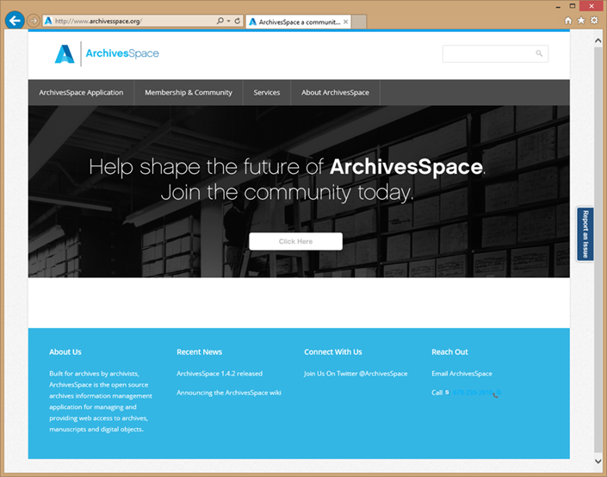
Current Example: ArchivesSpace
ArchivesSpace
Open source archives information management application
Background
Governance
Membership
Organizational home
Focus/Challenge
Transitioning organizations from software consumers to software supporters/users.
Notes:
Laurie
Given the larger context and matrix, thought it might be helpful to show a specific example – and how the organizational home model is designed to alleviate some of the “cons”
An examples is ArchivesSpace
Open source archives information management application
ArchivesSpace
There were two open source applications: Archivists Toolkit and Archon
In 2009 representatives of NYU, the University of Illinois Urbana-Champaign, the U of CA, San Diego, and the Mellon Foundation agreed to integrate the 2 into 1 application - in order to increase overall functionality within a single application and to optimize sustainability of the application.
Mellon provided funding for the first 2 phases
planning phase ran January 2010 to June 2011, drafted functional specifications, formulated a business plan, and secured an organizational home.
A development phase was July 2011 to Sept 2013, - release of ArchivesSpace 1.0 Sept, 2013.
Governance – governance board, technical advisory council and users advisory council;
Really fortunate to have engaged members on council and a
strong governance board and strong founding partners in NYU, U of Ill and UCSD; strong committed,
Membership
Incentivized to membership by access to documentation, training member listserv and support
270+ organizations – built in audience with Archivists Toolkit and Archon
LYRASIS serves as org home
staff work at LYRASIS; LYRASIS provides support in marketing, administration and technology
Separately LYRASIS also provides hosting services for AS users
Really pleased ahead of schedule – thanks to built in audience and strong partners
Focus/challenge
AS Functionality from previous systems
Managing community expectations while growing community
Transitioning organizations from software consumers to software supporters/users
Accustomed to “transactional” relationship - $ for service;
AS not a vendor; Not transactional –
Building a community and working together for a better product
Participation involved membership fee but also supporting and working together– vote/say in functionality and say in strategic direction
Community of support – peers, focus on software and larger problem; adva problem together
But that is not something they are accustomed to – working to slowly encourage community to solve issues together – example in support, give a man to fish vs teaching him to fish -

Slide 14
Questions
Are you using OSS?
What has been successful, and what has been challenging?
What projects/platforms are you evaluating now?
What services and support could LYRASIS put in place to remove barriers and/or improve success?
What are the costs/benefits of open source vs proprietary
Internal, external fte cost, annual service fees, training and support
Notes:
Robert leads
Are you using OSS?
What has been successful, and what has been challenging?
What are the barriers?
What services and support could LYRASIS put in place to remove barriers and/or improve success?
What projects/platforms are you evaluating now?

Slide 15
Thank you!
Notes:
Former CEO of DuraSpace and prior DSpace Foundationand Internet Archive. Have spent last 10 years working to develop/promote and sustain community developed open source softtare. Over the last 10-15 years I have noticed increasing number of projects and larger adoptoin particuarly in library and government- both in the US and internationally. Today I would like to kick off an engaging discussion regarding CCS to hear from you your experiences, your concerns and your opportuntitie. Lyrasis brought me on board to help develop their strategy for continuing to support and expand the communty source software programs they are the home for. Different size institutions have different challenges in adopting OSS, and Lyrasis has been working on how to remove those barriers to adoption- what needs to happen to help sustain the software and improve adoption.

Slide 16
15 Minute Break
Notes:
Former CEO of DuraSpace and prior DSpace Foundationand Internet Archive. Have spent last 10 years working to develop/promote and sustain community developed open source softtare. Over the last 10-15 years I have noticed increasing number of projects and larger adoptoin particuarly in library and government- both in the US and internationally. Today I would like to kick off an engaging discussion regarding CCS to hear from you your experiences, your concerns and your opportuntitie. Lyrasis brought me on board to help develop their strategy for continuing to support and expand the communty source software programs they are the home for. Different size institutions have different challenges in adopting OSS, and Lyrasis has been working on how to remove those barriers to adoption- what needs to happen to help sustain the software and improve adoption.

Slide 17
20 Minute Break
Notes:
Former CEO of DuraSpace and prior DSpace Foundationand Internet Archive. Have spent last 10 years working to develop/promote and sustain community developed open source softtare. Over the last 10-15 years I have noticed increasing number of projects and larger adoptoin particuarly in library and government- both in the US and internationally. Today I would like to kick off an engaging discussion regarding CCS to hear from you your experiences, your concerns and your opportuntitie. Lyrasis brought me on board to help develop their strategy for continuing to support and expand the communty source software programs they are the home for. Different size institutions have different challenges in adopting OSS, and Lyrasis has been working on how to remove those barriers to adoption- what needs to happen to help sustain the software and improve adoption.

