Slide 1
LYRASIS Leadership Forum 2016 Welcome wifi code: LAPL-Public
Your hosts: Robert Miller, Debra Hanken Kurtz, Cynthia Henderson, John Herbert, Jill Grogg, Laurie Arp, and Jenn Bielewski

Slide 2
eResources & Licensing
Jill Grogg
Licensing and Strategic Partnerships
Notes:
Former CEO of DuraSpace and prior DSpace Foundationand Internet Archive. Have spent last 10 years working to develop/promote and sustain community developed open source softtare. Over the last 10-15 years I have noticed increasing number of projects and larger adoptoin particuarly in library and government- both in the US and internationally. Today I would like to kick off an engaging discussion regarding CCS to hear from you your experiences, your concerns and your opportuntitie. Lyrasis brought me on board to help develop their strategy for continuing to support and expand the communty source software programs they are the home for. Different size institutions have different challenges in adopting OSS, and Lyrasis has been working on how to remove those barriers to adoption- what needs to happen to help sustain the software and improve adoption.

Slide 3
LYRASIS Licensing and Strategic Partnerships
Staffed by a team of 4 librarians
Rooted in work of legacy networks
Includes collaborative programs at national level

Slide 4
Material People Contribute to the Online World
Structured
Licensed content
Scholarly Open Access content
TEDx
Wikimedia
Kudos
Traditional
Non-traditional
YouTube
Digital humanities
Open data
Local/archival
collections and
repositories
Unstructured

Slide 5
Questions
Do you see the emphasis changing from content acquisition to content creation within your organization? Given stagnant budgets, what activities are no longer being performed so that efforts may be directed elsewhere?
What level of priority does your organization give to the creation and support of openly accessible content? And for what types of content and for whom?
What role should or does your library play in bringing together multiple departments to review new services that impact the entire organization? What role should LYRASIS play in expanding awareness of these services, and how can we assist members in this area?
What new models for hosting and accessing commercial content are being explored within your organization? What is the leading motivator, a desire for control or dissatisfaction with what commercial providers have developed so far?

Slide 6
Technology Three Points in a Circle
John Herbert
Director of Technology Services
Notes:
Former CEO of DuraSpace and prior DSpace Foundationand Internet Archive. Have spent last 10 years working to develop/promote and sustain community developed open source softtare. Over the last 10-15 years I have noticed increasing number of projects and larger adoptoin particuarly in library and government- both in the US and internationally. Today I would like to kick off an engaging discussion regarding CCS to hear from you your experiences, your concerns and your opportuntitie. Lyrasis brought me on board to help develop their strategy for continuing to support and expand the communty source software programs they are the home for. Different size institutions have different challenges in adopting OSS, and Lyrasis has been working on how to remove those barriers to adoption- what needs to happen to help sustain the software and improve adoption.

Slide 7
Circle of Life
Physical archive
Actual history
Describe
Finding aids
Collection
ArchivesSpace
PCDM
UMichigan
Digital Asset
Access
Discoverability
Aggregations
Item
Preservation
Permanence
Security
Infrastructure
Archidora
Islandora
Hydra
CDM
Archivematica

Slide 8
Open Source Community Supported Software
Laurie Gemmill Arp and Debra Hanken Kurtz
Director of Collections Services & Community Supported Software and CEO of DuraSpace
Notes:
Laurie bio
Title reflects the variety of great activities – Dig/pres, training/consult, community supported software
We wanted to take a little time to talk about Community supported software - Current trends; continued adoption and growth and also provided some specifics.

Slide 9
Operational overlap
DuraSpace
Ecosystem Programs
Digital Preservation Network (DPN)
SHared Access Research Ecosystem (SHARE)
Hydra in a Box (HyBox)
Community Source Software
Aspace
Cspace
DSpace
Fedora
VIVO
Hydra
Hosted
Services
Islandora
Aspace
Cspace
DSpaceDirect
ArchivesDirect
DuraCloud
LYRASIS Programs
Consulting
Digitization
Training & Professional Development
eResource Sales

Slide 10
End-to-End Asset Management Services
Plan
Consulting
Describe
ASpace
Manage/Access
DSpace
Preserve
Training
CSpace
DSpace
VIVO
Hydra/ Fedora
Islandora
ArchivesDirect
Fedora
DuraCloud
Digitization
Notes:
With this larger portfolio, the new organization can begin to think about how to bring these open source projects and services together so users/orgs can be fully supported at any step in the management of their digital content.
A merged organization brings together a broader participant base for community source projects which will promote greater adoption and provide a larger pool of technical expertise to grow the projects.
The combined services provide a diverse suite of tools for each step in the digital asset management process paired with professional expertise and consulting at every step.
Together, the organizations can pool expertise and participate in ecosystem activities to lead national preservation, curation, and data management efforts for benefit of their members and the broader academic community.

Slide 11
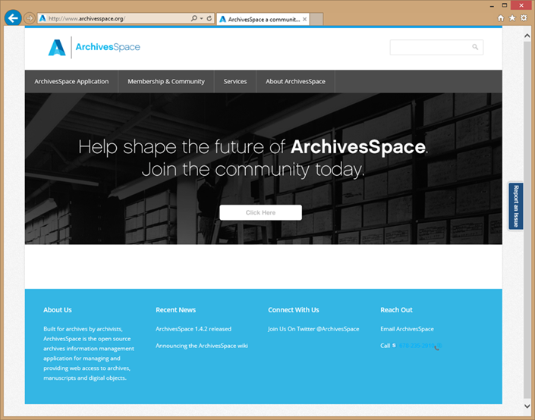
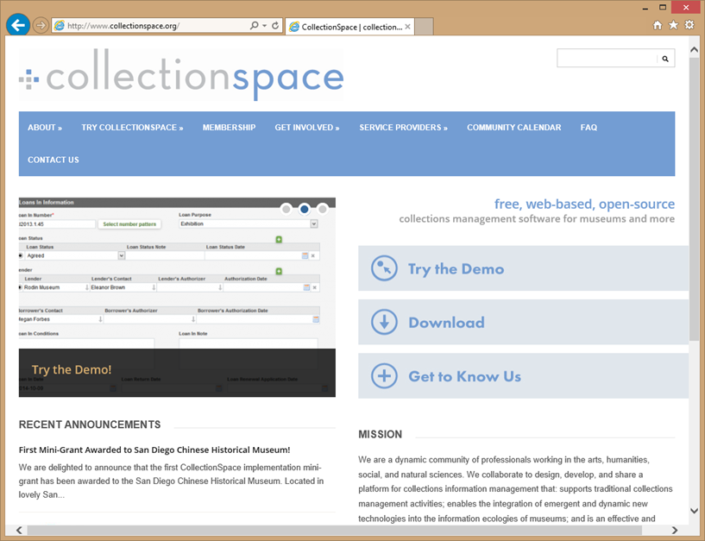
Current LYRASIS Examples
ArchivesSpace and CollectionSpace
Open source collections management software
ArchivesSpace
Background
Governance
Membership
Organizational home
CollectionSpace
Focus/Challenge
Transitioning organizations from software consumers to software supporters/users.

Slide 12
Questions
Are you using OSS?
What has been successful, and what has been challenging?
What projects/platforms are you evaluating now?
What services and support could LYRASIS put in place to remove barriers and/or improve success?

Slide 13
Open Source Software Trends
Continued adoption and growth in academic and government
Improved technical infrastructure for distributed development
github, SLAC, Jira
Agile development process
Continued evolution of sustainability models

Slide 14
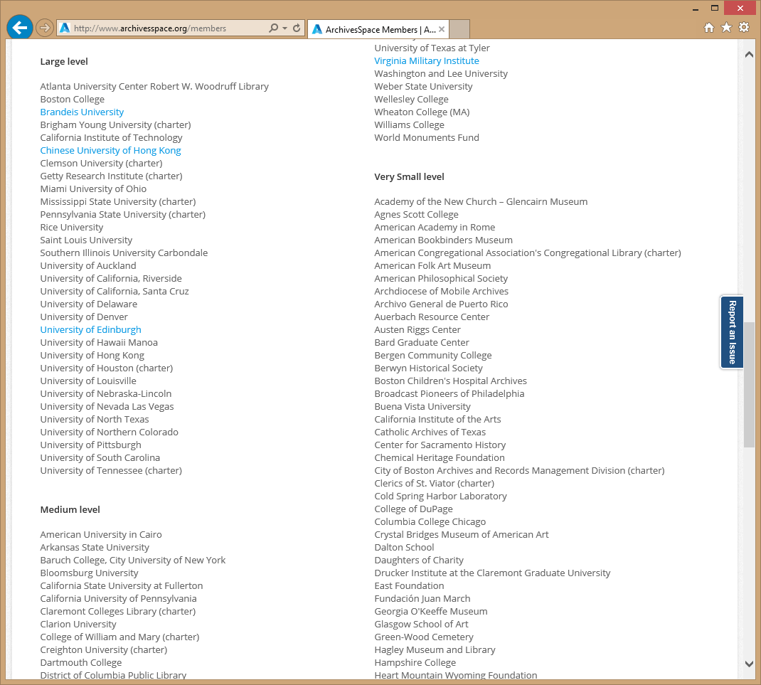
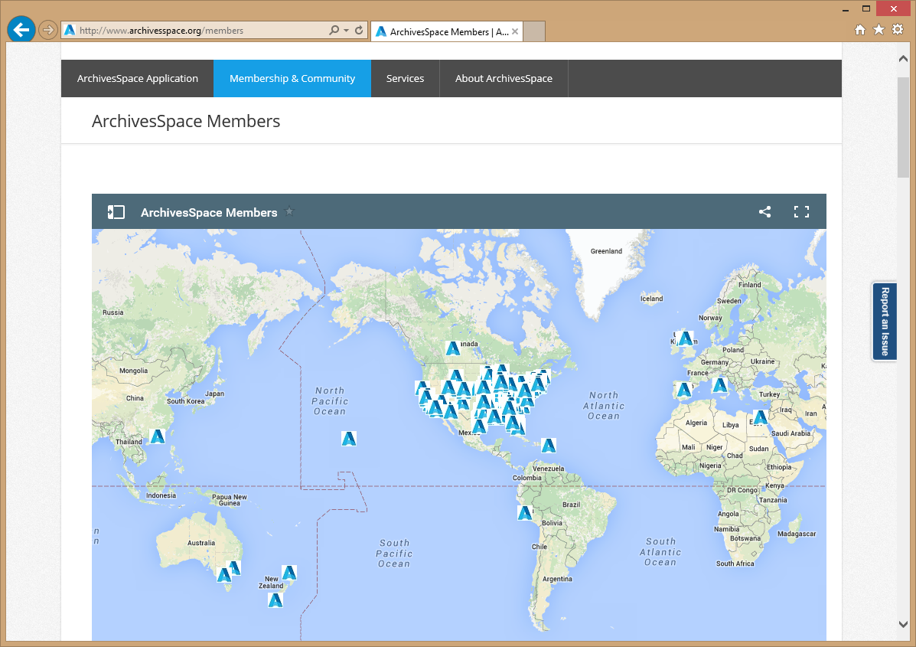

Slide 15
Examples

Slide 16
Open source community based software
Debra Hanken Kurtz, DuraSpace CEO
Notes:
Former CEO of DuraSpace and prior DSpace Foundationand Internet Archive. Have spent last 10 years working to develop/promote and sustain community developed open source softtare. Over the last 10-15 years I have noticed increasing number of projects and larger adoptoin particuarly in library and government- both in the US and internationally. Today I would like to kick off an engaging discussion regarding CCS to hear from you your experiences, your concerns and your opportuntitie. Lyrasis brought me on board to help develop their strategy for continuing to support and expand the communty source software programs they are the home for. Different size institutions have different challenges in adopting OSS, and Lyrasis has been working on how to remove those barriers to adoption- what needs to happen to help sustain the software and improve adoption.

Slide 17
Open source software trends
Continued adoption and growth in Academic and government
Improved technical infrastructure for distributed development (github,SLAC,Jira)
Open API’s to extend interoperability and functionality
agile development process
Continued evolution of sustainability models
Shared governance and administration
Financial sponsorship/membership
Establishment of Organizational home as administer (not for profit)
For profit home for support and services
Emerging vendor ecosystem
Membership
Service Providers
For profit and not for profit companies

Slide 18
Digital lifecycle management
Notes:
With this larger portfolio, the new organization can begin to think about how to bring these open source projects and services together so users/orgs can be fully supported at any step in the management of their digital content.

Slide 19
Questions
Are you using OSS?
What has been successful, and what has been challenging?
What are the barriers?
What services and support could Lyrasis put in place to remove barriers and/or improve success?
What projects/platforms are you evaluating now?
Does this diagram resonate in any way?

Slide 20
Challenges
Sustainability (community, financial, administrative, technical)
Support
Effort to collaborate
Resources required for adoption

Slide 21
Examples

Slide 22
Operational overlap
Notes:
Over the past years Lyrasis has made a strategic decision to support OSS, and currently is the organizational home for Collectionspace and archivesspace. As part of that strategy, LYRAsis would like to build a set of services that better enable institutions to use OSS and participate in OSS projects.
With the current “intent to merge” with DS, if successful, the new organization will be the org home for initially 6 open source projects and a number of complimentary services.

Slide 23
Thank you!
Notes:
Former CEO of DuraSpace and prior DSpace Foundationand Internet Archive. Have spent last 10 years working to develop/promote and sustain community developed open source softtare. Over the last 10-15 years I have noticed increasing number of projects and larger adoptoin particuarly in library and government- both in the US and internationally. Today I would like to kick off an engaging discussion regarding CCS to hear from you your experiences, your concerns and your opportuntitie. Lyrasis brought me on board to help develop their strategy for continuing to support and expand the communty source software programs they are the home for. Different size institutions have different challenges in adopting OSS, and Lyrasis has been working on how to remove those barriers to adoption- what needs to happen to help sustain the software and improve adoption.

Slide 24
15 Minute Break
Notes:
Former CEO of DuraSpace and prior DSpace Foundationand Internet Archive. Have spent last 10 years working to develop/promote and sustain community developed open source softtare. Over the last 10-15 years I have noticed increasing number of projects and larger adoptoin particuarly in library and government- both in the US and internationally. Today I would like to kick off an engaging discussion regarding CCS to hear from you your experiences, your concerns and your opportuntitie. Lyrasis brought me on board to help develop their strategy for continuing to support and expand the communty source software programs they are the home for. Different size institutions have different challenges in adopting OSS, and Lyrasis has been working on how to remove those barriers to adoption- what needs to happen to help sustain the software and improve adoption.

Slide 25
20 Minute Break
Notes:
Former CEO of DuraSpace and prior DSpace Foundationand Internet Archive. Have spent last 10 years working to develop/promote and sustain community developed open source softtare. Over the last 10-15 years I have noticed increasing number of projects and larger adoptoin particuarly in library and government- both in the US and internationally. Today I would like to kick off an engaging discussion regarding CCS to hear from you your experiences, your concerns and your opportuntitie. Lyrasis brought me on board to help develop their strategy for continuing to support and expand the communty source software programs they are the home for. Different size institutions have different challenges in adopting OSS, and Lyrasis has been working on how to remove those barriers to adoption- what needs to happen to help sustain the software and improve adoption.

