Slide 1
LYRASIS Leadership Forum 2016 Welcome
Your hosts: Loretta Parham, Julie Walker, Michele Kimpton,, John Herbert, Celeste Feather, Laurie Arp, Russell Palmer, Jenn Bielewski and Robert Miller

Slide 2
eResources & Licensing
Celeste Feather
Senior Director of Licensing and Strategic Partnerships
Notes:
Former CEO of DuraSpace and prior DSpace Foundationand Internet Archive. Have spent last 10 years working to develop/promote and sustain community developed open source softtare. Over the last 10-15 years I have noticed increasing number of projects and larger adoptoin particuarly in library and government- both in the US and internationally. Today I would like to kick off an engaging discussion regarding CCS to hear from you your experiences, your concerns and your opportuntitie. Lyrasis brought me on board to help develop their strategy for continuing to support and expand the communty source software programs they are the home for. Different size institutions have different challenges in adopting OSS, and Lyrasis has been working on how to remove those barriers to adoption- what needs to happen to help sustain the software and improve adoption.

Slide 3
LYRASIS Licensing and Strategic Partnerships
Staffed by a team of 4 librarians
Rooted in work of legacy networks
Includes collaborative programs at national level

Slide 4
Licensing Trends
Creating/enabling openly accessible content
New tools/services to enhance discovery, analyze use
Experimentation with new business models
Building communities

Slide 5
Open, Accessible, and Discoverable Content
Digitization services and equipment
Coordinating role for US
Open Library of Humanities
SCOAP3
Knowledge Unlatched

Slide 6
Tools and Services Supporting Access and Use
Alternative metrics (Altmetric)
Unique author/researcher identifiers (ORCID)
Describing research in lay terms (Kudos)
Curation of scholarly blogs (ACI Blog Index)
Virtual repository to compile all locally-created content (1Science)

Slide 7
New Business and Access Models
Local hosting of commercial content
Local control of access interface
Partnerships to develop new approaches

Slide 8
Building Community

Slide 9
Questions
Do you see the emphasis changing from content acquisition to content creation within your organization? Given stagnant budgets, what activities are no longer being performed so that efforts may be directed elsewhere?
What level of priority does your organization give to the creation and support of openly accessible content? And for what types of content and for whom?
What role should or does your library play in bringing together multiple departments to review new services that impact the entire organization? What role should LYRASIS play in expanding awareness of these services, and how can we assist members in this area?
What new models for hosting and accessing commercial content are being explored within your organization? What is the leading motivator, a desire for control or dissatisfaction with what commercial providers have developed so far?

Slide 10
Technology
John Herbert
Director of Digital Services
Notes:
Former CEO of DuraSpace and prior DSpace Foundationand Internet Archive. Have spent last 10 years working to develop/promote and sustain community developed open source softtare. Over the last 10-15 years I have noticed increasing number of projects and larger adoptoin particuarly in library and government- both in the US and internationally. Today I would like to kick off an engaging discussion regarding CCS to hear from you your experiences, your concerns and your opportuntitie. Lyrasis brought me on board to help develop their strategy for continuing to support and expand the communty source software programs they are the home for. Different size institutions have different challenges in adopting OSS, and Lyrasis has been working on how to remove those barriers to adoption- what needs to happen to help sustain the software and improve adoption.

Slide 11
Technology – Aggregating Digital Content
Trends
Provides much larger exposure while maintaining local identity
Single search portal for wide variety of content
State, regional, national level
Digital Library of Georgia, Texas Digital Library, Mountain West Digital Library
DPLA – doing well, but might not have all the answers
Hydra-In-A-Box designed to standardize metadata for aggregation
Great concept, but a couple years away

Slide 12
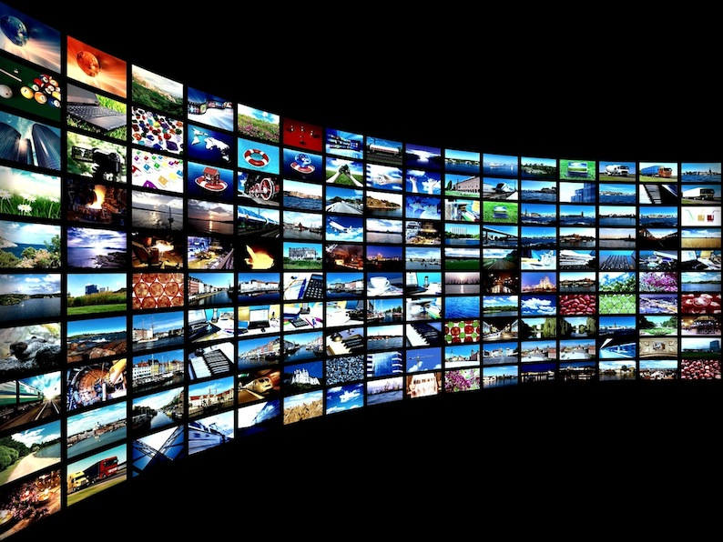
Technology – Aggregating Digital Content
Questions:
What level of interest do you have in participating in larger aggregations?
Are you actively engaged?
What services might you see as needed to make more progress?

Slide 13
Technology – Big Data
Trends
Granting agencies requiring it, at least for a few years
Faculty tend to deposit within their discipline, not necessarily within their institution
Wide variety of content, software, file formats
Long-term access and viability can be complex
Normalizing disparate data sets can develop a knowledge base

Slide 14
Technology – Big Data
Questions:
How much is your institution engaged?
Do you require faculty to deposit their data with you?
How do you balance the discipline-specific repository with your institution’s need for long-term preservation?
Are you building your own repository?
What additional services are needed to make more progress?

Slide 15
Technology – Open Publishing
Trends
Academic presses publish only a small portion of the research
Faculty looking for non-traditional publishing channels
Images, audio/video, data, indexing options
Web 2.0 social networking functionality

Slide 16
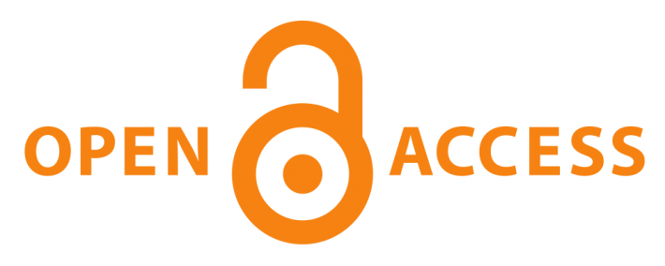
Technology – Open Publishing
Questions:
Is your institution providing any level of publishing assistance to faculty?
How do we influence tenure review committees to consider non-traditional publishing forms as viable?
Do you see this as a service you would like to develop?

Slide 17
Technology – Software
Trends
LAM IT departments increasingly dis-engaging from hosting/operating the multiplicity of software that are needed
Looking for more SaaS (Software as a Service) hosting options for processes of all kinds

Slide 18
Technology – Software
Questions:
How actively do you participate in cloud-based, hosting services?
How does your institution determine the make vs. buy decision on software?
How do we move away from application-specific solutions to full end-to-end software services?

Slide 19
Looking forward
Continued adoption and growth in Academic and government
Improved technical infrastructure for distributed development (github,SLAC,Jira)
Continued evolution of sustainability models
Shared governance and administration
Financial sponsorship/membershiip
Establishment of Organizational home as administer (not for profit)
For profit home for support and services
Emerging vendor ecosystem
Membership
Service Providers
For profit and not for profit companies

Slide 20
Open source community based software
Michele Kimpton
LYRASIS expert
Notes:
Former CEO of DuraSpace and prior DSpace Foundationand Internet Archive. Have spent last 10 years working to develop/promote and sustain community developed open source softtare. Over the last 10-15 years I have noticed increasing number of projects and larger adoptoin particuarly in library and government- both in the US and internationally. Today I would like to kick off an engaging discussion regarding CCS to hear from you your experiences, your concerns and your opportuntitie. Lyrasis brought me on board to help develop their strategy for continuing to support and expand the communty source software programs they are the home for. Different size institutions have different challenges in adopting OSS, and Lyrasis has been working on how to remove those barriers to adoption- what needs to happen to help sustain the software and improve adoption.

Slide 21
What is open source software?
Open-source software (OSS) is computer software with its source code made available with a license in which the copyright holder provides the rights to study, change, and distribute the software to anyone and for any purpose.
Open-source software may be developed in a collaborative public manner.
St. Laurent, Andrew M. (2008). Understanding Open Source and Free Software Licensing. O'Reilly Media. p. 4. ISBN 9780596553951.

Slide 22
Opportunities
Control
Transparency
Open Standards/ API’s (programmatic interfaces)
Cost
Shared resources
Attract and retain developers

Slide 23
Challenges
Sustainability (community, financial, administrative, technical)
Support
Effort to collaborate
Resources required for adoption

Slide 24
Examples

Slide 25
Looking forward
Continued adoption and growth in Academic and government
Improved technical infrastructure for distributed development (github,SLAC,Jira)
Continued evolution of sustainability models
Shared governance and administration
Financial sponsorship/membership
Establishment of Organizational home as administer (not for profit)
For profit home for support and services
Emerging vendor ecosystem
Membership
Service Providers
For profit and not for profit companies

Slide 26
Questions
Are you using OSS?
What has been successful, and what has been challenging?
What are the barriers?
What services and support could LYRASIS put in place to remove barriers and/or improve success?
How is the software being sustained and how do you participate in that model?
What projects/platforms are you evaluating now?

Slide 27
Thank you!
Notes:
Former CEO of DuraSpace and prior DSpace Foundationand Internet Archive. Have spent last 10 years working to develop/promote and sustain community developed open source softtare. Over the last 10-15 years I have noticed increasing number of projects and larger adoptoin particuarly in library and government- both in the US and internationally. Today I would like to kick off an engaging discussion regarding CCS to hear from you your experiences, your concerns and your opportuntitie. Lyrasis brought me on board to help develop their strategy for continuing to support and expand the communty source software programs they are the home for. Different size institutions have different challenges in adopting OSS, and Lyrasis has been working on how to remove those barriers to adoption- what needs to happen to help sustain the software and improve adoption.

Slide 28
15 Minute Break
Notes:
Former CEO of DuraSpace and prior DSpace Foundationand Internet Archive. Have spent last 10 years working to develop/promote and sustain community developed open source softtare. Over the last 10-15 years I have noticed increasing number of projects and larger adoptoin particuarly in library and government- both in the US and internationally. Today I would like to kick off an engaging discussion regarding CCS to hear from you your experiences, your concerns and your opportuntitie. Lyrasis brought me on board to help develop their strategy for continuing to support and expand the communty source software programs they are the home for. Different size institutions have different challenges in adopting OSS, and Lyrasis has been working on how to remove those barriers to adoption- what needs to happen to help sustain the software and improve adoption.

Slide 29
20 Minute Break
Notes:
Former CEO of DuraSpace and prior DSpace Foundationand Internet Archive. Have spent last 10 years working to develop/promote and sustain community developed open source softtare. Over the last 10-15 years I have noticed increasing number of projects and larger adoptoin particuarly in library and government- both in the US and internationally. Today I would like to kick off an engaging discussion regarding CCS to hear from you your experiences, your concerns and your opportuntitie. Lyrasis brought me on board to help develop their strategy for continuing to support and expand the communty source software programs they are the home for. Different size institutions have different challenges in adopting OSS, and Lyrasis has been working on how to remove those barriers to adoption- what needs to happen to help sustain the software and improve adoption.

